Slide 1
QUALITYstarsNY 2019 Project Updates
Leslie Capello, Director
Early Childhood Advisory Committee

Slide 2
Contact Information
Leslie Capello, Director
p: 718.254.7357
e: leslie.Capello@cuny.edu
Website: www.qualitystarsny.org
Social Media: @QUALITYstarsNY

Slide 3
New York State’s voluntary Quality Rating and Improvement System (QRIS) for early childhood programs
Designed to enhance the quality of early childhood for New York’s children and families
A strengths-based continuous quality improvement process with support and resources for early childhood professionals and the sites they work in

Slide 4
The New York Early Childhood Professional Development Institute is the coordinating agency for QUALITYstarsNY and manages its day-to-day operations.
The Institute is a public-private partnership that brings together a range of public agencies, a consortium of private funders, and the nation’s largest urban university, the City University of New York (CUNY), to drive the excellence of service designed for young children through research, policy, and practice.

Slide 5
Who we serve
800+ Participating Programs
Notes:
Licensed ECE programs
Family Child Care homes
Center Based CBOs
Public Schools – UPK, 3K
Programs begin the application process directly from our website & are provided support from an assigned QIS once they are accepted to participate. QIS are highly qualified ECE professionals who play a key role in supporting the continuous quality improvement cycle. We have 23 QIS across the state.
At this time, programs are put on track to participate in either SwS or begin immediately with the regular QSNY participation process.
SwS is in it’s third year (4th cohort) & is set up to support qualifying programs who are new, have experienced a change in leadership, or have been dealing with significant violations with their regulatory agency. It is designed to provide intensive support to programs over a 6 month period to prepare them for the Standards Inventory process related to regular QSNY participation & CQI. In SwS, programs receive; frequent visits with an assigned QIS, materials, PD, coaching, resources, and learning communities.

Slide 6
Rating Process & Star Levels
75 Quality Standards
Environmental Rating Scale
5-Star Levels
Notes:
QSNY was conceived as a comprehensive approach to quality; 4-Key Areas within the Standards; Learning Environment including child health & well-being, Family Engagement, Staff Q&E, Mgmt & Leadership
The rating process is focused on meeting the programs exactly where they are, at that point in time. Completing the Standards Inventory (75 Standards) & for some programs the appropriate ERS allows for a Star-Rating Level to be assigned & also provides our QIS with the baseline information needed to begin discussing next steps with a program.
The CQI process begins with the outcome of the Rating (points earned for each of the 75 Standards) & when applicable, the ERS scores. All of this information is documented in the Quality Improvement Plan (QIP) where the program leader sets goals & creates action items towards quality improvement that are directly connected to indicators within the Standards.
A strengths based approach builds a strong & trusting relationship with a program leader & consistently supports & empowers this person in their role.

Slide 7
Cycle of Continuous Quality Improvement
Assessment
Quality Improvement Plan
Support & resources – Quality Improvement Specialist
Resources
Notes:
Program assessment data is used to inform the development of the QIP & resources are directly connected to the assessment data to advance quality & excellence.

Slide 8
Continuous Quality Improvement (CQI)
Support from QIS
Classroom materials & other resources
Coaching
Professional Development
Notes:
At the foundation of CQI is the QIP – this plan is the basis for how each individual program receives the comprehensive services that QSNY provides. The QIP is developed through a partnership between the QIS & the program leader where reflection on the assessment data leads to creating goals & action items related to;
Technical Assistance
Regular visits & accessibility
Partnership with program goal setting & attainment
Learning Communities – can take place at programs &/or in partnership with local CCR&Rs, libraries, or other community agencies that allow for meeting space to hold the meetings
Materials & Resources
Furniture, children’s books, play materials, outdoor equipment
Some cases; flooring, climbing equipment,
Leadership books for learning communities
Coaching
Professional Development
PD is developed in partnership with local CCR&Rs, institutes of higher education – community partnerships are the key factors in meeting the PD needs of programs

Slide 9
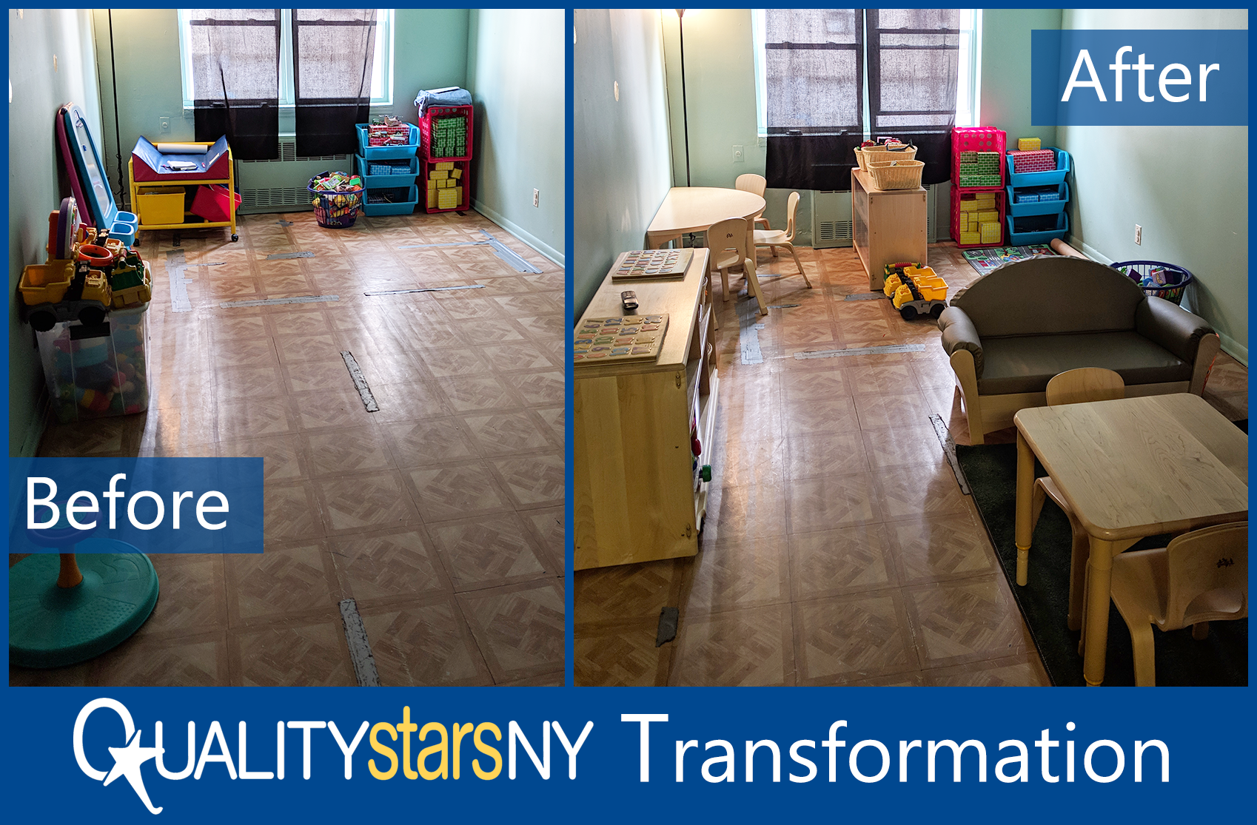
Notes:
FCC Brooklyn; went through the participation & rating process, received an ERS & worked with QIS to set goals. Some action items for goals are; 1) create learning interest areas (blocks, math/science-nature, fine motor 2) create a well defined dramatic play area 3) materials needed 4) recruitment for enrollment/post laminated flyers 5) include social emotional development experiences into daily interactions & planning –
1-Star Rating - Q&E retention & experience but goals are set to enhance “qualifications” so educational attainment for administrator & staff.
The QSNY Standards, meeting programs where they’re at, strengths based & WILLINGNESS to learn, grow, take action, improve – CQI!!!

Slide 10
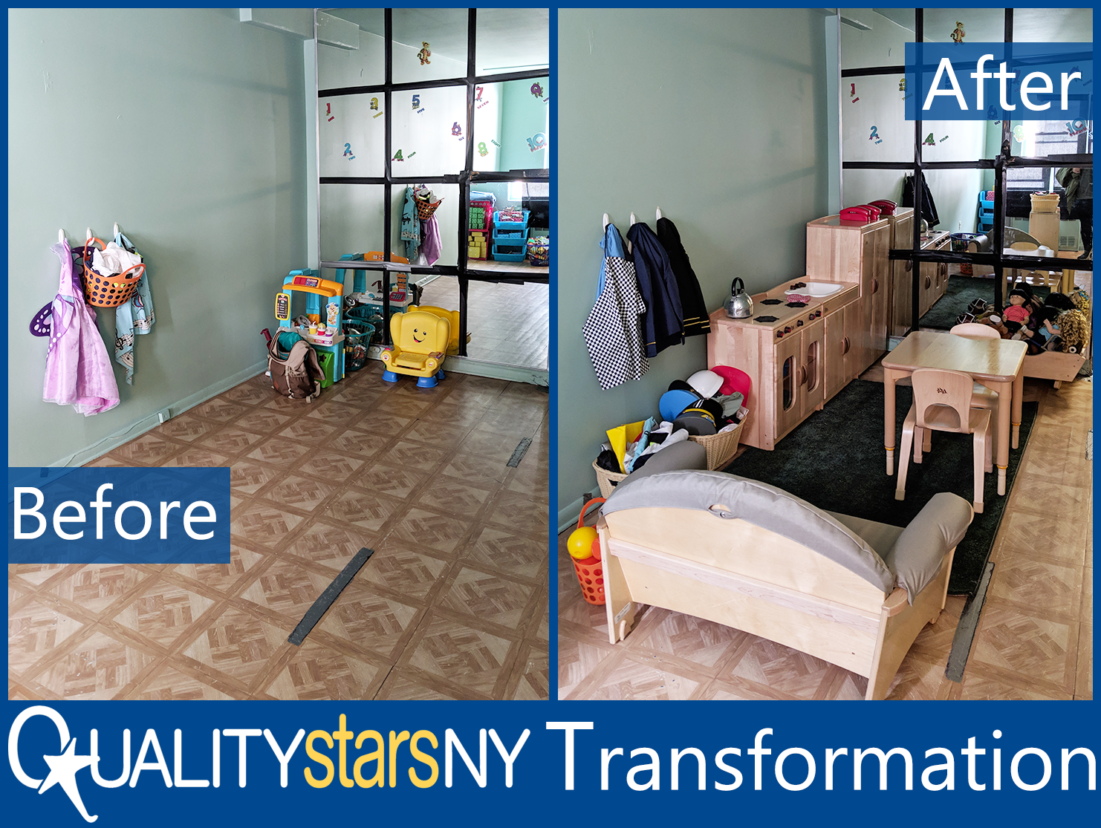

Slide 11
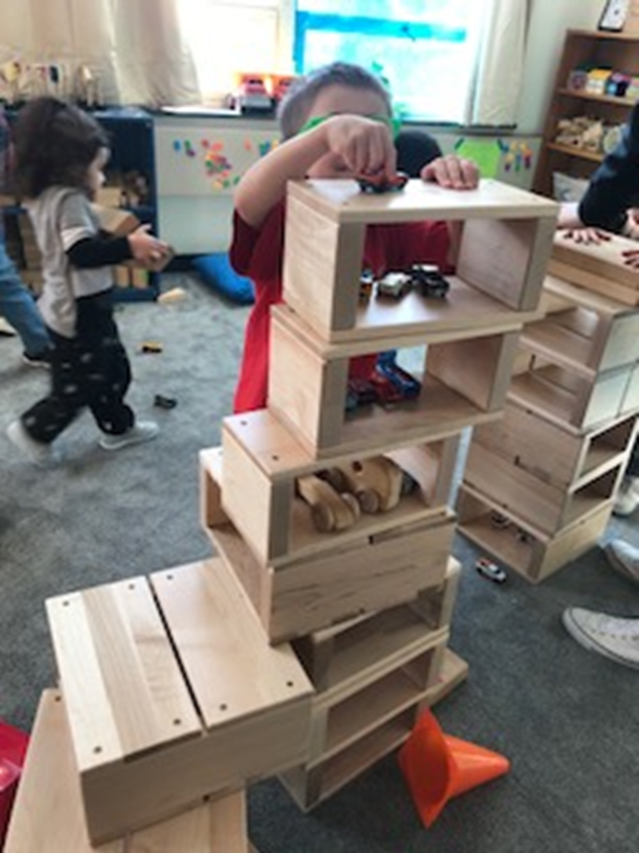
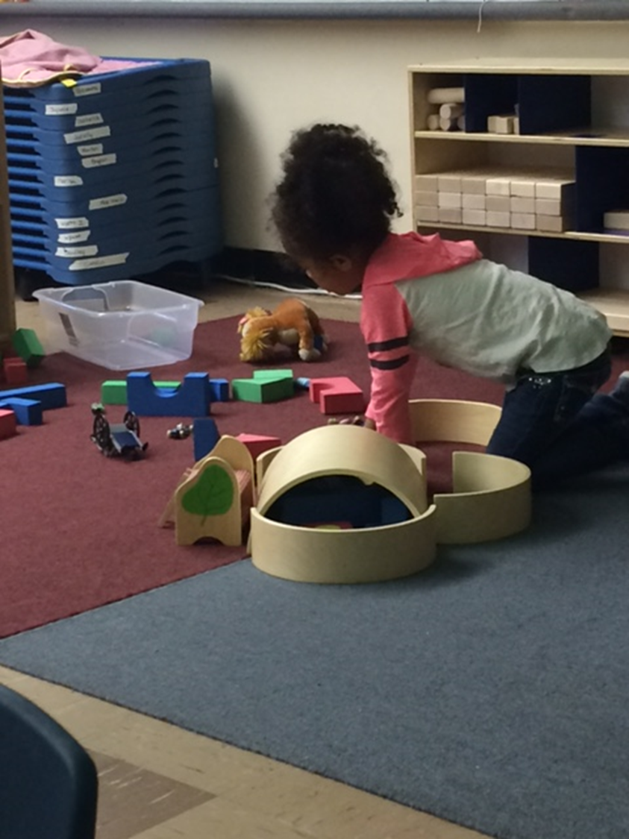
Notes:
In these photos, we see the children engaged in classroom materials purchased as part of the QIP to add gross motor materials to the classroom;
Campus based child care center SUNY – 2 locations; remember the Standards & ERS information informs goal setting & action items
enhance blocks & accessories for daily use other action times to support goals included; PD for I/T specific, conferences, leadership conference for administrator, complete a self assessment using PAS, curriculum books, coaching, outdoor play equipment & materials, replacing broken leaky water table – over a 3 year period
add gross motor – large hollow block units, attend conferences & institutes, PD for curriculum implementation, complete college coursework toward degree attainment staff & administrators, complete training for PAS & complete self assessment using PAS, sensory area/art, develop family survey – over a 3 year period

Slide 12
Re-Rating Data
843 rated programs
276 have been re-rated
196 received a 2nd rating
80 received a 3rd rating
Notes:
From the first re-rating cycle up until May 2019 – the re-rating cycle is continuous based on a program’s enrollment date in QUALITYstarsNY.
Re-rating is set up in 3 year cycles with an option of submitting for a re-rating after 18 months of participation

Slide 13
Re-Rating Data
76% of all re-rated programs*
Increased Star-Rating or maintained a 4 or 5 Star Level
*n=276
Notes:
After our initial re-ratings, we saw dramatic improvement & increase in Star Levels. Of course, we immediately wondered & hoped we could sustain these gains over time. The number of sites that maintained their 4 or 5 star rating over 3 years told us what we needed to know.
What we know about the 276 re-rated programs - 76% (see slide)

Slide 14
Re-Rating Data
2nd Rating n=196
49% Maintained
50 % Increased Star Levels
3rd Rating n=80
36% Maintained
53% Increased Star Levels
Notes:
2nd Rating –
49% Maintained
(50) – 3, 4, & 5 Stars
(43) – 1 & 2 Stars
50 % Increased Star Levels
(57) one Star Level
(31) two Star Levels
(7) three Star Levels
3rd Rating –
36% Maintained
(24) – 4 Stars
(6) – 2 Stars
53% Increased Star Levels
(29) one Star Level
(11) two Star Levels
(2) three Star Levels
Of the 1 or 2 Star level programs who completed re-rating, 64% increased their Star-Rating level
We know from this data that within the QIP goals were set, action items were completed & improvements were made to align with the Standards & this was reflected in the movement of Star levels
Maintained > when we don’t see an increase in Star-Rating level, we do see an increase in scores within indicators; 75% of all re-rated programs increased their scores across indicators by an average of 29 points (total without ERS 1-2 Star Levels = 290 & total with ERS 3-5 Star Levels = 340)

Slide 15
Re-Rating Data
What we know about the <1% of programs that decreased points during re-rating;
Leadership turnover
Teacher turnover (retention)
Notes:
<1% decreased (16/276 programs) – data has provided us an opportunity to look deeper into these instances > analyze & compare points for the (75) Standards at the indicator level, review goals/support, other factors that are revealed in the data (leadership turn over, teacher retention, staff qualifications & experience)
Trends we see in ECE programs impacting rating/re-rating scores that do not increase or in some cases, drop in points or Star-Rating level;
Leadership turnover
Teacher turn over (Q&E)
Opportunities to impact change, QSNY & other initiatives focused on workforce development; Career Center, Leadership Institute – PDGB-5 grant will support replication of the Leadership Institute so more ECE program leaders can benefit from the initiative.

Slide 16
Start with Stars Overview
Intensive support for new programs or those with significant licensing challenges
6-months
Frequent visits with Quality Improvement Specialist
Resources
Notes:
2017 begin >targets new sites & most challenged sites (struggling with meeting licensing regulations, changes in leadership) – intensive support over 6 months, assigned QIS, frequent visits & contact (2-3 times per month), resources, PD, coaching, & materials. All receive an ERS as a baseline assessment to inform development of a QIP (goals & action items to address immediate issues & plans to improve quality). CQI begins with the assessment, goals/action items are developed within the QIP & supports are provided based on the identified goals/action items.
Where available, SwS program leaders participated in the Leadership Initiative.

Slide 17
Start with Stars Measure of Success
Completion of the program & successful transition to regular QUALITYstarsNY participation
Star Rating level of SwS participating programs at first rating
Participant evaluations

Slide 18
Start with Stars Participants
My Quality Improvement Specialist is an amazing support to me. She has taught me many things that are fundamental to child care. She has been a fantastic support along our journey together & I am forever grateful to have benefited from her time, knowledge, patience, experience, & expertise.
Notes:
Participant evaluations form the 1st cohort provide both quantitative & qualitative data. Nearly 100% of programs (48 programs) who responded said that their contact with their QIS was “very helpful”.

Slide 19
Start with Stars (SwS) Data
Percent of programs that transitioned to regular QUALITYstarsNY participation after the 6-month period
Average first rating of SwS programs compared to first rating for programs that did not participate in SwS
Number & percentage of SwS programs that received 3, 4, or 5 Star rating when transitioned to regular QUALITYstarsNY participation
Notes:
The intensive support provided during SwS participation has been effective in preparing for the Standards inventory process, which teaches program leaders about the elements of quality & why these elements are important to the overall improvement of their programs – benefits to children & families who attend high quality programs.
Currently developing reports to analyze data for (see slide)
When we looked at first rating of all programs, those who participated in SwS were rated slightly higher than those who did not.
We’re taking programs that were much more challenged, providing support, & they are earning points equal to or slightly higher than program in regular QUALITYstarsNY
If asked: 1.6 to 1.8 & 2.4 to 3.5

Slide 20
Summary
QUALITYstarsNY
has a positive impact on progress & sustained quality in early childhood
Notes:
CQI is effective with all of the necessary supports, a strength based approach, & the willingness of program leaders & staff who want to improve quality for the children & families they serve.

Slide 21
Validation Study
SEQUAL
Supportive Environmental Quality Underlying Adult Learning
Tool used to capture teacher perspectives across (5) domains of their work environment:
Teaching Supports
Learning Community
Job Crafting
Adult Well-Being
Program Leadership
Notes:
Our goal was to engage in an overall study of our Standards in comparison with the SEQUAL measures. We know that our 4-5 Star Level programs did better on the SEQUAL study.
http://cscce.berkeley.edu/sequal/ Center for the Study of Child Care Employment (CSCCE) of UC Berkeley
The SEQUAL is a multi-purpose validated tool for examining and improving environments in which early childhood teaching staff work and learn. The SEQUAL assesses how well the workplace supports teaching staff to learn and to continue to develop their knowledge and skills on the job. It is administered directly to teachers and assistant teachers in centers or school-based programs.
2018 Study / Published April 2019 - Teacher’s Voices: Work Environment Conditions that Impact Teacher Practice and Program Quality – NY (center based), Minnesota, Miami
Findings reveal that common workplace challenges pose barriers to early child care educator well-being and classroom effectiveness. Findings also demonstrate the value of program policies that ensure dependable workplace supports and policies such as provisions for paid planning and reporting time.

Slide 22
Participation in the Study
What did we want to learn from the study?
Would QUALITYstarsNY’s high Star-Rating levels coincide with the scores on the SEQUAL tool?
“…teaching staff working in higher-rated centers tended to assess their work environments more positively…”
Notes:
What did we want to know from the study?
In conclusion, the study did find that teaching staff working in higher-rated centers tended to assess their work environments more positively but there is improvement needed across all rating levels
Adult Well Being
Staffing & Teaching Supports
Professional Development & Guidance

Slide 23
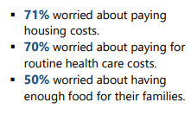
Detailed Findings
Economic insecurity of the workforce

Slide 24
Detailed Findings
Student Loan Debt
42% reported accruing student loan debt &
52% of teaching staff who reported student loan debt had loans in excess of $25,000
Notes:
All rated sites were invited to participate – 125 sites volunteered – sites across all star ratings were represented.
356 teachers & 66 program leaders completed the survey
51% of centers where both teachers & program leaders responded
QSNY Standards are recognized as one of just three states making gains towards supportive work environments for teachers for achieving program quality (Teacher Practice & Well-Being in the SEQUAL tool);
Paid time for PD
Paid planning/prep time
Paid time for vacation/holidays
Salary schedule
Offering benefits
Retention/staff turn over rates are also included in the rating

Slide 25
Funding – FY2020

Slide 26
Private Funding & Governor’s Budget
Current
Stella & Charles Guttman Foundation
East New York
Potential
Developing (2) new private funding sources

Slide 27
Preschool Development Grant B-5
PDGB5 - Awarded $1.4M
Recruitment in high-need communities
System’s building
Notes:
Expanding;
Hiring 2 FT QIS & 1 PT
NYC – Bronx, Brooklyn (ENY/Brownsville), Manhattan (Washington Heights, Harlem)
Finger Lakes (Rochester)
Mid Hudson (Dutchess, Ulster, Orange)
Data tracking & reporting system – enhance features, add to existing functions

Slide 28
Questions?
Leslie Capello, Director
p: 718.254.7357
e: leslie.Capello@cuny.edu
Website: www.qualitystarsny.org
Social Media: @QUALITYstarsNY

