Slide 1
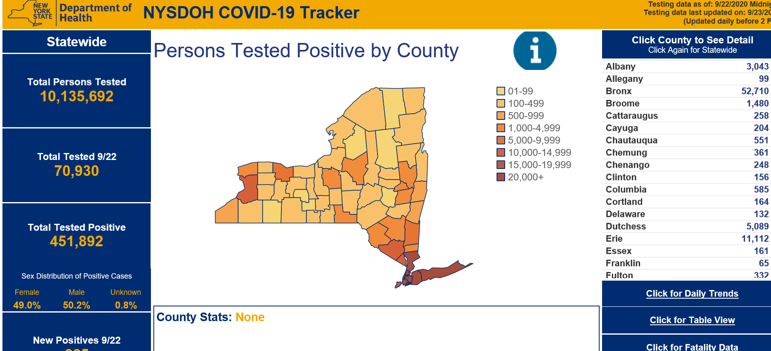
https://covid19tracker.health.ny.gov

Slide 2
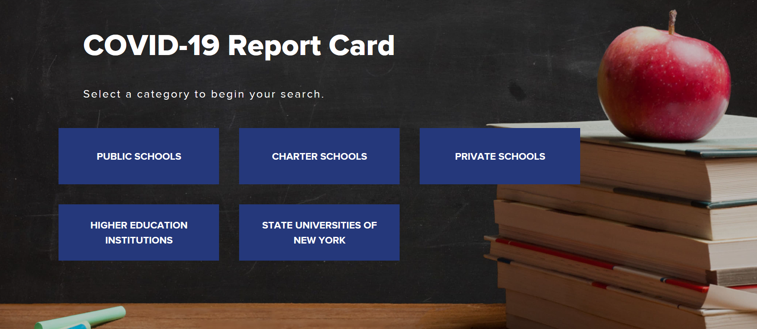
https://schoolcovidreportcard.health.ny.gov/#/home

Slide 3
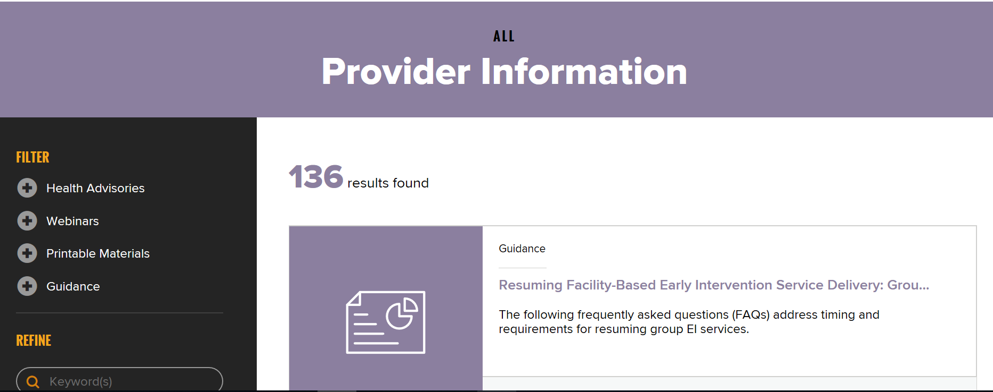
https://coronavirus.health.ny.gov/information-healthcare-providers

Slide 4
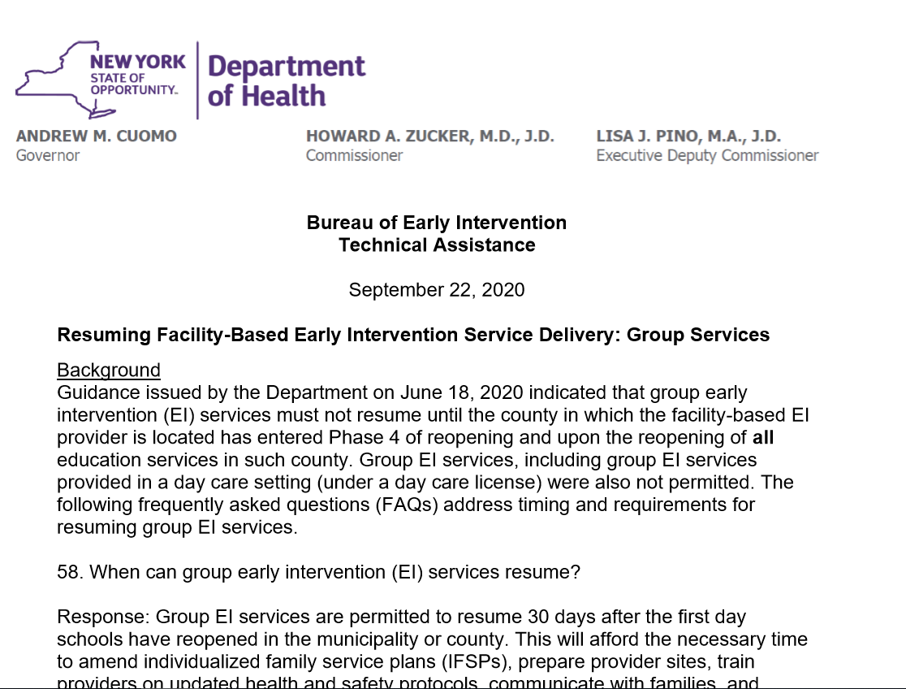
For questions regarding this information, please contact the Department at beipub@health.ny.gov or 518-473-7016.

