Slide 1

New York State
Early Childhood Advisory Council
Focus Area Highlights
December 14, 2017

Slide 2
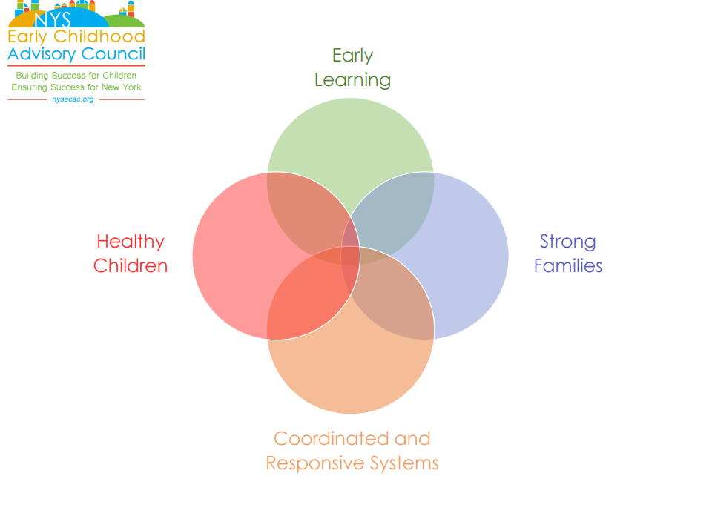

Slide 3

Early Learning

Slide 4
Early Learning
Objective 1: Align the current diverse set of early care and education programs and services to become a unified and integrated system for children from birth to age 8.
  Priority Action G: Provide guidance for aligning all New York Prekindergarten Programs into a single full-day program that ensures adequate funding for classrooms operated by school districts and community-based program providers.
    FY 2018 Budget
  Priority Action H: Support OCFS in the development of the new Child Care and Development Fund plan and provide guidance to the state in the plan’s implementation.
    Professional Development Recommendations
    Coaching
    Individualized Professional Learning

Slide 5
Early Learning
Objective 2: Increase the knowledge and competencies of Early Care and Learning Workforce
  Priority Action I: Through Advisory Committee, support development and implementation of the State Plan of the National Academy of Medicine’s recommendations on transforming the workforce.
Objective 3: Establish compensation, recruitment and retention strategies to ensure New York has the early childhood workforce necessary to implement a high quality early learning system.
  Priority Action to be established:
  Correlates directly with Power to the Profession and NAM work.
  Data collection is key to addressing this objective.

Slide 6
Early Learning
Objective 4: Support the developmentally appropriate practice in programs birth through grade 2.
  Priority Action J: Promote the use of New York’s Early Learning Framework (i.e., Core Body of Knowledge, Early Learning Guidelines, QUALITYstarsNY, and Prekindergarten Foundation for the Common Core) in all settings serving children birth through age 8 and at all levels of the system (e.g., standards, professional preparation, professional development, service delivery, etc.) to ensure high quality, developmentally appropriate early learning programs.
  Priority Action K: Support the development of strategies to align P-3 development and learning standards (ELGs, PreK Foundation, and K-3 Learning Standards) with developmentally appropriate curricula and assessment.
      The Office of Early Learning will begin work on Priority J and K in January.
      ECAC EL work group would be willing to vet the work.
      Need to track use of these documents (and DAP’s) and how they are employed in practice.

Slide 7
Early Learning
Objective 4: Support the developmentally appropriate practice in programs birth through grade 2.
  Priority Action M: Reinforce the use of the Pyramid Model in providing appropriate guidance and professional development to staff, in educating and supporting families, and in collaborations with community partners, with the goal of reducing the number of children who are suspended or expelled from early childhood programs.
    Training
    Coaching
    Data
    Technical Assistance

Slide 8
Early Learning
Looking forward…
  Short Term:
    Capitalize on current state and national work
    Tailor Early Learning objectives and priority actions to recommendations from current work.
  Medium to Long Term:
    Continue to refine our objectives and priority actions based on current context
    Continue to evaluate the Early Learning groups unique role
    Establish co-leads for each objective
    Develop measures for evaluating progress

Slide 9
Healthy Children: 2017 Progress Update
Focus Area Objective: Promote optimal health and development in all domains, including social-emotional development
Chairs: George Askew & Mary McHugh
Priority Action
Strategies to support implementation of universal developmental screening and referral in primary care and early care settings
Priority Action
Strategies to support implementation of universal maternal depression screening and linkages in primary care
Priority Action
Advance research, knowledge and skills to address SEL needs of young children across multidisciplinary workforce

Slide 10
Healthy Children: 2017 Progress Update
Priority Action: Universal Developmental Screening and Referral in Primary Care and Early Care and Learning Settings
Co-Chairs: Evelyn Blanck & Liz Isakson
Collaborate with key stakeholders in health policy to advance universal developmental screening in primary care
Workgroup advanced 4 priority recommendations as part of the First 1,000 Days on Medicaid Initiative
Workgroup members actively participate in the two NYS Pilots as part of the NYS ECCS Impact Team
Preventive Pediatric Care Clinical Advisory Group and
Workgroup actively involved in the Children’s Medicaid Redesign
Actively engaged in the First 1,000 Days on Medicaid Initiative
Data System Development for Cross Sector
Two proposals were selected in the top ten to advance:
In 2018, collaborate on the development of above proposal
Build community partnerships and linkages to better ensure universal developmental screening
Promote resources such as Birth to Five Watch me Thrive across NYS

Slide 11
Healthy Children: 2017 Progress Update
Priority Action: Universal Maternal Depression Screening and Linkages for Prevention and Intervention
Co-Chairs: Evelyn Blanck & Liz Isakson
Promote behavioral health strategies to support maternal depression treatment within primary care
Collaborate with key stakeholders in health policy to advance maternal depression screening and linkages in primary care
Advance findings from the OMH Healthy Steps Initiative that demonstrate key strategies for increasing depression screening, linkages and to identified services
Workgroup advanced 3 priority recommendations as part of the First 1,000 Days on Medicaid Initiative
Workgroup advanced one priority recommendation as part of the First 1,000 Days on Medicaid Initiative
Peer Family Navigator Pilot was selected in the top ten
Parent Diagnosis as Eligibility for Parent Child Therapy was selected in the top ten
Currently advancing resources from the AAP Screening Technical Assistance & Resource (STAR) Center. Created to help practices support long-term child health and development through early childhood screening, referral, and follow-up for developmental concerns, maternal depression, and social determinants of health.
In 2018, continue collaboration with DOH Medicaid polices
In 2018, collaborate on the development of above proposal

Slide 12
Healthy Children : 2017 Progress Update
Priority Action: Professional Development to Effectively Address Social-Emotional Development Across the Infant and Early Childhood Multidisciplinary Workforce
Chair: Wendy Bender
Advance statewide pyramid model implementation and expansion in early care and learning settings
20 schools/agencies are participating in Cohort 1
Advance NYS-AIMH competencies and endorsement system
Promote dissemination of JTSED guidance document on best practices for meeting the SED needs of young children and their families
Conducing a comprehensive review of all NYS early childhood endorsements/credentials to align with NYS-AIMH
In 2018, align work with EICC workgroup dissemination plan
7,073 people trained on Pyramid Model to date
Braided Funding secured for 2018
Work with CCF to promote guidance and track website requests
To date, crosswalk has been completed on CDA credential, NYSPEP credential and Pyramid Model competencies
In 2018, develop communication strategy to disseminate crosswalk
In 2018, continue to evaluate the three-year cycle of comprehensive support and technical assistance to Cohort 1

Slide 13
Strong Families
Priority 1: Promote parent voice and effective culturally competent family engagement strategies in all early childhood programs and services.
Family Engagement Guidance Document
-Family Driven
-Directed at Agencies and Organizations
-Protective Factors Frame work as context for engaging families.
-Principles of Family Support Practice
-Recommendations for promoting family engagement.

Slide 14
Strong Families
Objective 2: Increase opportunities for all families to gain the knowledge, skills, confidence, and social supports needed to nurture the health, safety, and positive development of children.
New York State Parenting Education Partnership
-Continued commitment to statewide professional development
-Community Initiatives
-Parent Voice

Slide 15
Strong Families
Objective 3: Increase the proportion of vulnerable/at risk families (e.g., homeless families, families with children with special needs, children exposed to trauma or violence) that are identified and provided with needed supports and services.
Early Childhood Home Visiting
-MIECHV Reauthorization
-NYS Medicaid First 1000 Days Initiative
Vulnerable Populations – Immigrants

Slide 16
Coordinated and Responsive Systems
Five Work Teams
Supporting Communities
Finance
Data Development
Business Advisory Group
Homeless Children and Families

Slide 17
Coordinated and Responsive Systems
Supporting Communities Work Group
Dana Friedman, Chair
Objective: Support comprehensive community planning and systems building.
Priority Action: Identify and promote community-based initiatives designed to benefit young children and their families.
Strategy: Provide support to communities in developing and implementing strategies to improve services for young children and their families.

Slide 18
Coordinated and Responsive Systems
Supporting Communities Work Group
Work to Date
  Identified 26 communities located across the state with some level of coordinated systems building work.
  At least 10 of these initiatives are fully formed with paid staff.
  Identified representatives from each of the communities to serve on work team
  Held 4 in-person full-day meetings and five conference calls with work team members
  Organized conference calls with representatives of 10 states that have developed statewide initiatives to fund and support community initiatives

Slide 19
Coordinated and Responsive Systems
Work to Date – Continued
Drafted a proposal for the development of a similar initiative to fund and support community initiatives in New York State. Proposal is currently on hold.
Working toward holding a Leadership Development Institute to support the professional development of the leaders of New York’s early childhood systems building initiatives.

Slide 20
Coordinated and Responsive Systems
Finance Work Group
Stephanie Woodard, Chair
Objective: Increase public-private investments into early childhood.
Priority Action: Maximize early childhood program funding.
Strategies: 1) Increase use of the fiscal model
2) Develop innovative funding strategies
3) Provide guidance on maximizing existing funding

Slide 21
Coordinated and Responsive Systems
Finance Work Group
Work to Date
Developing 3 new guides to support blending & braiding existing funding:
  Early Childhood Education Funding – ways to effectively blend and braid child care subsidies and fees, Head Start and Early Head Start, and Prekindergarten funding.
  Title XX - using Federal Title XX funds to support child care for families who are in receipt of child welfare services (preventive, protective, and foster care).

Slide 22
Coordinated and Responsive Systems
Finance Work Group
Work to Date - Continued
  Universal Early Childhood Home Visiting: providing a step-by-step process of blending and braiding funds to support a universal early childhood Home Visiting program using the United Way of Greater Rochester systems integration Home Visiting model.
Maximizing use of the “Fiscal Analysis Model for Early Childhood Services”

Slide 23
Coordinated and Responsive Systems
Data Development Work Team
Carol Saginaw, Cate Bohn, Bob Frawley Co-chairs
Objective: Support the development of a coordinated, comprehensive early childhood education program data system.
Priority Action: Support efforts to link data on early childhood program participants, programs, and staff and administrators
Strategy: Develop a marketing strategy to convince decision makers of the value of building a cross program data system.

Slide 24
Coordinated and Responsive Systems
Work to Date
Awarded a technical assistance grant from Child Trends to develop a marketing strategy to support linking data from the nine state and NYC early childhood data systems.
Worked with Child Tends in the development of a:
  Stakeholders analysis and marketing strategy
  Marketing brief on the value of an integrated early childhood data system
  Brief that describes our work to date
  Dissemination plan to state agency heads and then Governor’s Office.

Slide 25

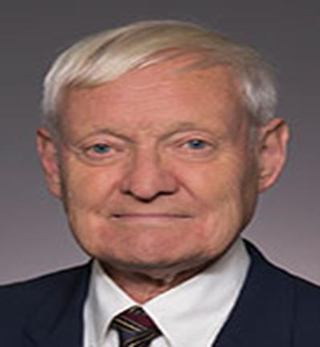
Coordinated and Responsive Systems
Work delayed briefly, because Carol’s Husband Joachim Frank
Won the Noble Prize for Chemistry

Slide 26
Coordinated and Responsive Systems
Other Good News
Both the First 1000 Days Task Force and the Regent’s Blue Ribbon Commission have funding recommendations for integrated early childhood data.

Slide 27
Coordinated and Responsive Systems
Business Advisory Group
Patty Persell and Sherry Cleary Co-chairs
Objective: Increase public-private investments into early childhood.
Priority Action: Develop and implement a public engagement campaign to obtain support for early childhood services.
Strategy: Develop a business leader advisory group to support the ECAC’s efforts strengthen and expand early childhood services.

Slide 28
Coordinated and Responsive Systems
Business Advisory Group
Work to Date
Identified three members and recommended them for appointment
Began working with the Steering Committee on the development of a Business Summit

Slide 29
Coordinated and Responsive Systems
Homeless Children and Families Work Team
Jennifer Pringle and Melanie Faby – Co-chairs
Objective: Promote policies and statutes that ensure a coordinated and responsive continuum of high-quality services.
Priority Action: Develop a set of strategies to support children experiencing homelessness.

Slide 30
Coordinated and Responsive Systems
Homeless Children and Families Work Team
Work to Date
Conducted panel on issues related to homeless children at the March ECAC meeting
Co-chairs responsible for implementing changes to McKinney-Vento legislation
Work Group will reconvene in January

