Slide 1

Welcome to the
ECAC Membership Meeting
9/24/20

Slide 2
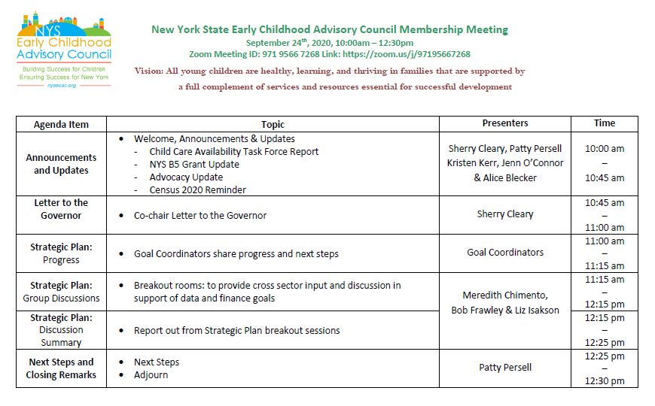

Slide 3

Child Care Availability Taskforce

Slide 4
Child Care Availability Task Force
Core Principles of a High-Quality Child Care System
Equitable Access. A high-quality child care system will be accessible to all children from birth through school age regardless of income, race, ethnicity, immigration status, geographic location, or ability. Every child should be able to reach its full potential for healthy cognitive, physical, social and emotional development.
Affordability. All New York families will have equitable access to affordable high-quality child care from birth through school age regardless of income, race, ethnicity, immigration status, geographic location, or ability. To be affordable, families with gross family income equal to or less than 100% of the federal poverty level shall not pay for child care; families with gross family income between 150% of the federal poverty level and 100% of the federal poverty level shall pay no more than 7% of gross family income; and all other families shall pay no more than 10% of gross family income. (Draft recommended changes)
High-Quality. A high-quality child care system will support children’s learning and development, have an appropriately compensated and skilled workforce, an effective and streamlined professional development infrastructure, and clear, consistent accountability standards and procedures that make the quality of all providers universally clear and transparent to parents and families. The accountability standards must be responsive to the pluralistic needs of this diverse sector of professionals, as well as the modalities and communities that they serve.
Coordinated. A high-quality child care system will be part of a data-driven, coordinated early care & learning system with consistent, responsive standards, requirements, assessments, monitoring, etc.
Supportive and Nimble. A high-quality child care system is innovative, nimble and future-thinking. It is both supported by and supportive of businesses in the community. The system is ingrained in the community and supports the regional workforce as well as child care workers, especially in the face of changing technology and evolving workplace norms. A high quality child care system will increase the labor participation rate of parents with young children, reduce turnover, absenteeism and productivity losses, and boost New York State’s economic development.

Slide 5


NYS B5 Grant Update

Slide 6


Advocacy Update

Slide 7

Census 2020
Current Deadline: 9/30/20

Slide 8
State Agency Update
Shared with you via the Zoom Chat
NYS Office of Children and Family Services
  Janice Molnar
NYS Education Department, Office of Early Learning
  Jason Breslin
NYS Department of Health
  Kirsten Siegenthaler

Slide 9
Co-Chair Letter to the Governor

Slide 10
ECAC Strategic Plan Update

Slide 11
Goal 1: Infrastructure
Goal Coordinators: Sherry Cleary & Patty Persell
Items Underway:
Next 6 Months:
Communicate recommendations to Governor Cuomo
Conducting an audit of current membership; crosswalk with Strategic Plan and Codification to determine need for new membership
Meetings coordinated to maximize strategic plan
Coordinating across state agencies
Up-dating and increasing function of website
Featuring statewide and community-based initiatives
Continue work started in first 6 months
Coordinating business and philanthropy
Develop next year’s recommendations for Governor Cuomo

Slide 12
Goal 2: Family Engagement
Goal Coordinators: Pedro Cordero & Tim Hathaway
Items Underway:
Next 6 Months:
1. Outreach to engage organizations that potentially support the development of the PAC and ongoing work of the ECAC.
The first draft of the PAC manual is complete. The manual is under review for graphic and content changes.
3. PAC Application is launched!
Link to PAC application : https://www.surveymonkey.com/r/NYSECAC-PAC2020
Texting number application: Text to nysecac to 31996
Identification and Orientation of PAC parents.

Slide 13
Goal 3: Quality
Goal Coordinator: Kristen Kerr
Items Underway:
Next 6 Months:
Identified activity leads
Working to update progress indicators for each activity for better alignment
Create meeting schedule with activity leads
Identify additional active participants
Develop detailed work plans and timelines
Complete resource inventory outlined in 3.B.1

Slide 14
Goal 4: Whole Child
Goal Coordinator: Kirsten Siegenthaler
Items Underway:
Next 6 Months:
Offering Pyramid Model modules and coaching to implementing programs at no cost to participants across all regions of the state
Started to train 19 new Master Cadre TTAP trainers to become Master Pyramid Model trainers/coaches
Pyramid Model Implementation Data System (PIDS) to link with Aspire Registry database
Positive Solutions for Families offered to families virtually during the pandemic
Safe sleep and hearing screening information added to NYS Baby Bundle (new baby kit) being piloted in 11 areas of the state
Expand Pyramid Model to 25 additional implementation sites, supported by the Pyramid Model Hubs
Present Pyramid Model data to stakeholders at state conferences and State Leadership Team annual meeting
ACES and Protective Factors trainings and materials will be disseminated to the early childhood workforce
Challenges to address oral health in early childhood will be collected and addressed

Slide 15
Goal 5: Partnerships
Goal Coordinator: Patty Persell
Items Underway:
Next 6 Months:
Transition requirements across all early childhood programs will be presented soon
Community-based best practices are highlighted on the ECAC website
Additional kindergarten transition teams will form across the state
Kindergarten transition teams will meet regularly across the state
Ten more Kindergarten Transition Summits will be scheduled
Transition practices will be posted and shared in additional formats

Slide 16
Goal 6: Workforce
Goal Coordinator: Sherry Cleary
Items Underway:
Next 6 Months:
5 Career Centers (1 original and 4 satellites) are running with staff and serving 5 regions, building relationships with higher education and community partners.
Series-based professional development to introduce and support newly revised Early Learning Guidelines
Revision of Career Ladder has begin
Identify regional needs and gaps, begin planning
Plans for new Career Centers will be implemented in year 2 of PDGB-5
Re-energize recruitment of ECE professionals to earn the TTAP credential
Vet revised Career Ladder with a statewide group of stakeholders
Operationalize plans to fill critical needs and gaps in the workforce across the state.

Slide 17
Goal 7: NYWfC
Goal Coordinator: Jeanne Galbraith
Items Underway:
Next 6 Months:
NYC Career Center and Career Center Satellites are up and running. Meeting and exceeding deliverables.
Working on planning new Career Centers – Finger Lakes and Hudson Valley
Creating Welcome Letter from the ECAC to be included with distribution of “Welcome Kits” for new programs.
Survey of Higher Education Early Childhood courses across NYS
Webinar - Higher Education – NYSED/NY PDI - Focus on using Early Learning Guidelines/Core Body of Knowledge
Higher Education Forum – Spring 2020 consider faculty and student recruitment strategies, coursework, alignment, residency opportunities, and other issues to enhance higher education performance.

Slide 18
Goal 8: Fiscal
Goal Coordinator: Bob Frawley & Meredith Chimento
Items Underway:
Next 6 Months:
Individual and group meetings held with activity leads and key contributors
Leads forming groups and beginning to meet
Blending and braiding guides developed
Infographics on existing tax credits developed and approved
Analyze existing funding sources and gaps
Promote employer and parent tax credits
Develop strategies for funding ECIDS, Aspire and QUALITYstarsNY

Slide 19
Goal 9: Data
Goal Coordinator: Liz Isakson
Items Underway:
Next 6 Months:
Initial Meeting held
Groups forming
Prioritization and timelines in process
Awaiting release of:
  Determining the Feasibility of Creating a New York State Early Childhood Integrated Database report from Center for Human Services Research
Next 6 months:
  Form 4 distinct work groups
  Connect with other states that have existing ECIDS for updates/lessons learned
  Prepare clear asks and scopes of work for any technical assistance
  Bring in the technical expertise early to inform choices

Slide 20
Goal 10: Research
Goal Coordinator: Patty Persell & Sherry Cleary
Items Underway:
Next 6 Months:
Early Childhood research collection has begun Improved the ECAC website to include a sections about COVID resources and new section with local, state, and national best practices in action Working on ways to share the Needs Assessment information with families that participated and families at large
Create ‘best practices’ criteria and dissemination plan

Slide 21
Discussion: Break Out Sessions
Finance: Goal 8
Data: Goal 9
Meredith Chimento
and Bob Frawley
Liz Isakson
Please Report Out at 12:15

Slide 22
Next Steps & Closing Remarks
Thank you!

