Slide 1
Welcome & Introductions
Welcome to the ECAC Membership Meeting!
If you are joining us via phone and/or your full name does not appear
please type your full name and email into the comment section
June 18th 2020

Slide 2
ECAC Letter to the Governor: Race Equity in NYS
Dear Governor Cuomo,
Thank you for your leadership through the COVID-19 Pandemic. We are proud New Yorkers serving as your Early Childhood Advisory Council (ECAC). Our nearly 50 members, representing public agencies and non-profit organizations across the state, support the state’s regions in preparation to re-open, acknowledging how critical child care and family health and welfare is to our economic recovery and social fabric.
As you have acknowledged, there has been dramatic and disproportionate loss and suffering in our black and brown communities due to COVID-19 in New York State. Early childhood is not free from racial inequities and experiences: young black children are twice as likely to die in the first year of life. The ECAC is committed to race equity and is poised to partner with any initiative your office creates in order to better understand the challenges and develop tangible and actionable solutions for children and families.
The ECAC’s commitment to race equity is demonstrated throughout our new strategic plan which focuses on developing systems, policies and practices to support the most underserved populations, over the next three years. Additionally, the ECAC recently hired a Family Engagement Coordinator to work across the state with our most vulnerable families to hear their voices, illuminate their needs, and generate solutions.
As New York ‘builds back better’ and seeks economic recovery through a strategic and phased reopening we must consider the impact each phase will have on working families with young children, always keeping our most vulnerable families as our focus. We offer comprehensive support. This includes, but is not limited to, the urgent need to address equitable distribution of technology to mitigate our current resource gap as we rely increasingly on telecommunication for medicine, education, and interpersonal support. The ECAC would like to offer our support and the expertise of our membership of early childhood experts in any and all ways we can be helpful to you. Our members are prepared to serve on a range of committees or task forces addressing racial disparity across systems.
Thank you,

Slide 3
Talking is Teaching Poster by Emma Geyer

Slide 5
^{Introduction}
The vision of the New York State Preschool Development Birth Through Five project (NYSB5) is for every child in New York to be supported by a mixed- delivery system that is informed by parent voice and provides access to high quality, equitable, and comprehensive early care and learning environments and services essential for successful development and lifelong success. The New York State Council on Children & Families allocated 2.35 million for the implementation for a state wide mass media campaign, Talking is Teaching.
Objectives & Priority Population
A statewide mass media campaign was the chosen activity to increase parents’ knowledge of NYS Early Childhood System.
The goal of the campaign was to empower parents and caregivers of young children who are a part of underserved or marginalized communities including single-parent homes, multilingual homes, low- income homes, those experiencing temporary homelessness, etc,.
^{Talking is Teaching}
An initiative of Too Small to Fail, CCF adopted Talking is Teaching marketing materials and added the CCF logo and Parent Portal website url. The marketing materials were translated into 6 additional languages including Spanish, Bengali, Chinese, Haitian Creole, Korean, and Russian.
^{NYS Parent Portal}
CCF created a user friendly, all-in-one site where parents and caregivers can go for guidance, information, and tools. The Parent Portal brings together several resources for parents to one convenient and user-friendly location. From the Parent Portal, users can access several sites which include the New York State Parent Guide, New York State’s Childcare Program Locator, Every Student Present, and the New York State Multiple Systems Navigator.
Notes:
We worked with NYSDOH, NYS OCFS, NYSED and Head Start to develop 11X17

Slide 6
Strategic Approach
Out of Home mediums (OOH) included busses, buss shelters, hair and nail salons, bodegas, laundromats, subway cars, billboards, changing stations, mall banners, elevator wraps, and take-one’s in doctors offices. Digital mediums included social medial, search engines such as Google, streaming websites, and TV commercials.
Limitations
Difficult to measure to specific impact of OOH materials
Consider targeting older adults who may be involved with raising a young child.
Targeting rural populations.
Conclusions
Paid media placements drove nearly 46,000 new users to the Parent Portal site during the paid digital media campaign.
Mobile devices drove the majority of the traffic to the site, while desktop devices drove the longest average session duration (30 seconds).
Languages had similar click through rate with the exception of English and Spanish as top performers.
Notes:
We worked with NYSDOH, NYS OCFS, NYSED and Head Start to develop 11X17

Slide 7
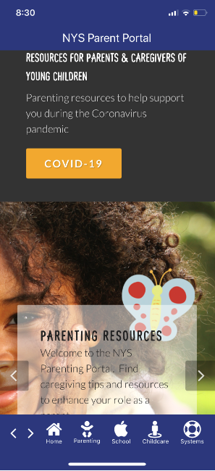
What’s next?

Slide 8
Child Care Update in a COVID-19 World Early Childhood Advisory Council June 18, 2020
Janice Molnar, Deputy Commissioner, Division of Child Care Services
Meredith Chimento, Executive Director, Early Care & Learning Council

Slide 9
NYS Actions in Support of Families & Providers
Supports for Families - Waived family share for families affected by COVID-19 - Expanded subsidy eligibility up to 85% of the state median income - Expanded the definition of a child needing protective services - Extended the eligibility period for child care
Supports for Programs - Allowed regulatory flexibility - Expanded the number of paid child absence days - Expanded the number of paid program closure days
CARES Scholarships and Supplies

Slide 10
CARES Scholarship and Supplies $30 Million beginning April 20, 2020

Slide 11
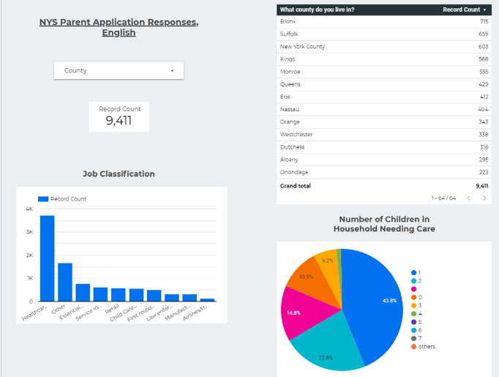
CARES Scholarship
Total Parent Applications Received:
June 15: 10,137
June 8: 9,609
June 1: 8,963
May 26: 8,280
May 19: 7,494
May 12: 6,195
May 5: 4,786

Slide 12
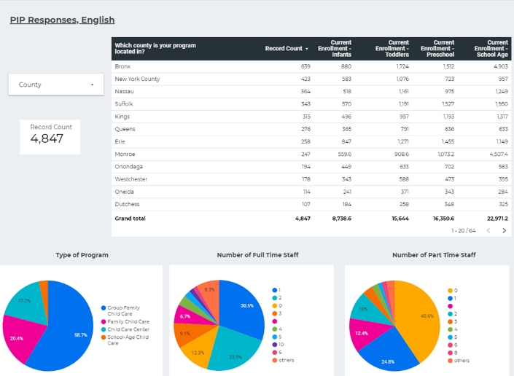
CARES Scholarship
Total Provider Information Profile:
June 15: 5,110
June 8: 5,028
June 1: 4,935
May 26: 4,776
May 19: 4,627
May 12: 4,309
May 5: 3,814
Total open licensed and registered programs in NYS:
June 16: 10,393
June 8: 10,409
June 1: 10,360

Slide 13
CARES Scholarship Cumulative since April 20, 2020 22 out of 32 CCR&Rs reported
Expenditures for Provider Scholarship $ 2,957,912.39
3,474 approved parent applications
983 providers receiving scholarships
Expenditures for Supplies: $ 2,273,972
Total number of providers receiving supplies: 4,038
Totals on this report taken from 22 out of 32 CCR&R contracts

Slide 14
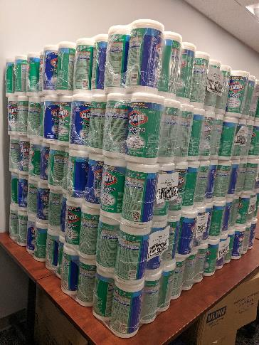
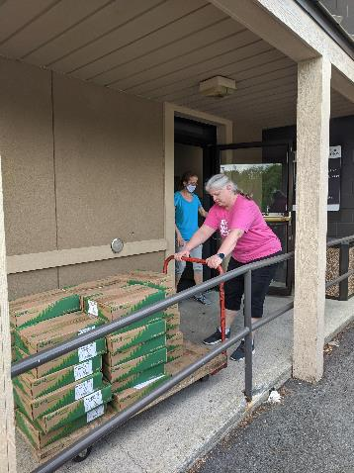
Supply Distribution Child Care Council of Dutchess & Putnam,Inc.

Slide 16
Emergency Regulations
Regulations for Legally Exempt, Licensed and Registered Child Care Programs
Parts 414, 415, 416, and 417 and Subparts 418-1 and 418-2 of Title 18 of the Official Compilation of Codes, Rules and Regulations of the state of New York (NYCRR) are hereby amended to read as follows:
An eligible provider must operate in compliance with all emergency health guidance promulgated by the Department of Health in interest of public health during a designated public health emergency. Provided that, during a designated public health emergency, any relevant emergency directives from the executive chamber or from the Department of Health shall supersede regulations of the Office in the case of any conflict.

Slide 17
Interim Guidance for Child Care and Day Camp Programs During the COVID-19 Public Health Emergency – Eff. 6/8/20
Organized around three distinct areas:
People
Places
Processes

Slide 18
I. People
Physical Distancing
Caring for Young Children
Child Care Program and Camp Activities
Gatherings in Enclosed Spaces
Workplace Activity
Movement and Commerce

Slide 19
People
Programs must ensure that employees wear face coverings at all times when interacting with children.
Group size must be limited to no more than ten (10) children excluding staff.
Programs should maintain a staffing plan that does not require employees to “float” between different classrooms or groups of children, unless such rotation is necessary to safely supervise the children due to unforeseen circumstances (e.g. staff absence).

Slide 20
II. Places
A. Protective Equipment
C. Hygiene, Cleaning, and Disinfection
D. Phased Reopening
E. Communications Plan

Slide 21
Places
Programs must train their employees on how to adequately put on, take off, clean (as applicable), and discard PPE, including but not limited to appropriate face coverings.
Child care programs must maintain logs that include the date, time, and scope of cleaning and disinfection.
Programs should post signage inside and outside of the facility to remind individuals to adhere to proper hygiene, social distancing rules, appropriate use of PPE, and cleaning and disinfection protocols.

Slide 22
III. Processes
Screening and Testing
Tracing and Tracking

Slide 23
Processes
Child care programs must instruct staff to stay home if they are sick and remind parents/guardians to keep sick children home.
Programs must implement mandatory daily health screening practices of their employees, visitors, parents, and children.
Daily health screening may be performed remotely, before the individual reports to the child care, to the extent possible; or may be performed on site.

Slide 24
Thank you
We thank you for your extraordinary efforts in continuing to serve children and families during this challenging and difficult time.
We stand ready to assist in whatever way we can.
Division of Child Care Services Website: https://ocfs.ny.gov/programs/childcare/#COVID19
Early Care & Learning Council Website: https://earlycareandlearning.org/

Slide 25
COVID-19 Response Share Out: NYS Department of Health Kirsten Siegenthaler

Slide 26
COVID-19 Response Share Out: NYS Education Department,
Office of Early Learning Jason Breslin

Slide 27
COVID-19 Response Share Out: NYS Early Care and Education Survey, Understanding the Impact of COVID-19 on our NYS Early Education System
Sherry Cleary

Slide 28
COVID-19 Response Share Out: Self Care Poll
Please complete our second anonymous poll

Slide 29
PAC: Parent Advisory Council
Tim Hathaway, Pedro Cordero & Yvette James
The New York State Parent Advisory Council (PAC) is an integral component of the New York Early Childhood Advisory Council (ECAC) in assisting in the planning, implementation, monitoring and evaluating policies, practices and services that impact children and parents/caregivers. New York’s early care and education system will benefit from the collective wisdom of the PAC and the expertise of the individual parent/caregiver members. The parent/caregiver members are considered genuine, active voices participating in the shaping of system development and delivery.
A Parent Advisory Council parent/caregiver member shall be:
A parent/caregiver with a child/ren (prenatal to ten years)
A person that brings lived experience as a parent/caregiver
PAC members will conduct their work from the following:
A strength-based approach which is defined as placing emphasis on the positive attributes of the individual and successes of the process to build areas in need of development. In this dynamic, embracing the strengths is important, yet developing strategies to improve and grow is the priority.
An equity lens approach, inclusive of race, gender, sexual orientation, etc. This will require members to be intentional about the understanding of how equity and power dynamics directly impact the welfare and freedom of oppressed/vulnerable populations. Also, members will be open to examine, dissect and/or create solutions.
PAC members are invited to participate in all ECAC activities. This will involve discussing ideas, Parent Leadership conference planning and development of policy proposals as well as other issues that directly and/or indirectly influence parents/caregivers, their child/ren and the community at large. Two representatives of the PAC are invited to participate on the ECAC Steering Committee.
PAC members will be supported with a wide range of professional development.

Slide 30
NYS ECAC Parent Advisory Council (PAC) Considerations Survey Results

Slide 31
Q1. After you read the PAC document is anything missing? Does anything need clarification?
It might be helpful to create a document specifically for parents with simpler language.
I think it should be made clear in the document that a parent/caregiver must be included in each of the Strategic Plan Goals.
I think the first paragraph should have a phrase or sentence about race equity - it shouldn't be raised for the first time in the very last bullet.
Just be certain to add parents, guardians, caregivers. Also, I think it's important to say "personal and professional development opportunities" or "leadership opportunities". I think it will be important to review the document for reading level and consider having it translated. We want to raise parent voice but it should also be clear that PAC will partner with us to collectively problem solve solutions as well.
Will PAC members be liaisons on our committees as well?

Slide 32
Q1. cont.
Might be helpful to give a sense of expected time commitment to parents and indicate that there will be a range of ways to participate (in person and remotely). Might also be helpful to provide a real life example of a policy where parent input would be especially important to craft policies.
How do parents get invited to serve on the PAC? Do all parents on the PAC get to serve on the ECAC Steering Committee or do they select representatives (the sentence about serving on the Steering Committee sounds like everyone)? Is there cross over from the ECAC on to the PAC?
Who leads the PAC and how does that get determined - will there be leadership? Is there a desired number of PAC parents (an upward limit or a minimum?) How often should the PAC meet?
Does the PAC have to meet as a group? Or can they just work on SP goals?
6 responses said nothing missing

Slide 33
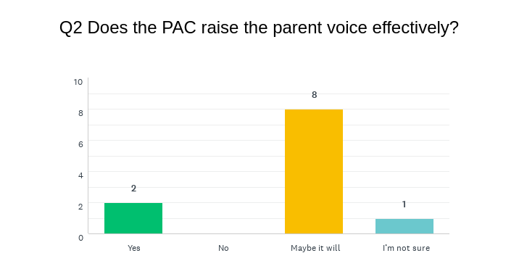

Slide 34
Comments:
As co-chairs of the Strong Families workgroup, either Tim or I can be part of the ad-hoc committee.
The PAC could have time on every ECAC agenda too.
I think the menu of possible ways in which parents could participate in ECAC activities should be included in the PAC document.

Slide 35
Q4. Obstacles to engaging parents
Ensuring families are engaged and present, accommodating meetings to families’ schedules.
Need to explore creative options to engage families with young children and thus enabling families for real input i.e. participation at meetings; time to comment on publications, research, etc.
Technology barriers (if meetings are conducted virtually).
The COVID environment is an obstacle but we all need to do our best keeping communication going well virtually. In some ways it may be helpful in promoting involvement since no one needs to travel.
Daytime meetings, paying in advance for travel expenses (when we are able to gather in person), Broadband/bandwidth for parents interacting with meetings, etc. online.
Parents may have a difficult time traveling/being away from home if the meetings are in person. Is it possible to extend the age of the child to be over 10 years old? Parents may have a child over the age of 10. These parents could contribute many experiences that they/their children have encountered.

Slide 36
Q4. cont.
Competing priorities for parents.
The location of ECAC meetings (when we are allowed to be in person)
Different ideas around what makes a parent/caregiver/guardian a "good fit" for participation on the PAC.
Will it be someone's job to coordinate/facilitate this process (I believe there is a position created to do this)...having meetings that work for families, keeping families motivated to participate in this work, taking the time to really engage family voice takes more time and more communication... Making sure their role is more than symbolic - that they feel they are co-creating with the ECAC.
Reimbursing parents for their participation/providing child care remains an obstacle.
Pace of policy change can be off-putting for all, but especially those not regularly engaged in policy work and those who are most in need of swift change.
Parents with young children don’t have a lot of time. It would be good if they could be connected from home, and be engaged in the parts of the SP that they are most interested in. They should not have to attend all the ECAC meetings to be involved in this work.

Slide 37
Q5. Solutions for obstacles?
Creating a genuine prof dev (leadership) plan (physical or virtual) for families with certificates and/or credentials.
Provide equipment and training on how to be an effective voice.
Every professional paired with a parent for a week - ride along so to speak to share notes and ask for helpful hints.
Parents voices are very important. Virtual meetings which may have to happen may help with attendance and comfort level of participation.
Move the ECAC meeting around the state.
Keep ongoing training of the technology for all who may need it to continue to communicate in a virtual environment.
Pair each PAC person with an ECAC member (buddy system).

Slide 38
Q5. Solutions
Dedicated staff person/people who commit to focusing in parent voice and reminding us to keep parent voice at the center of our conversations/discussions.
Realistic expectation of the amount of time it will take to engage family voice at a very diverse and inclusive way Virtual meetings may be a great approach for being respectful of the amount of time it takes for parents to be engaged with system level work Continuous monitoring of process to make sure the PAC is meeting the interests of parents.
Ensure that parents are compensated for their time by providing funds - need to creatively solve this longstanding obstacle.
Create non-intrusive means for parents to participate - via quick surveys, phone calls, written communications. Regularly reinforce and remind parents how important their voice/input is and encourage them to not be disheartened when change is slow.
Flexibility, stipends, use Zoom when possible.

Slide 39
ECAC Strategic Plan Roles
Goal Coordinator: A member of the ECAC Steering Committee, each coordinator or co-coordinators will guide the guide the work of the entire goal. They will work strategically with the Leader/Conveners for each of the activities in the goal. The Coordinator will help to set the priorities for the overarching goal and the order in which the activities should occur, per the progress indicators, and help set deadlines for each activity. The Goal Coordinators will be responsible to collect and share goal progress and accomplishments with the Steering Committee and ECAC quarterly.
Leader/ Convener: One or more ECAC Members (might be a staff member if it makes sense). (Purpose is to get the members to commit to leadership roles when possible). Is responsible for the SP activity progress and for guiding the activity’s progress.
Active Participant: ECAC Member or member designee who can contribute to the activity on a regular basis until the activity is completed. The workers, the ones getting the actual work accomplished.
Expert/ Resource Person: Designated for their area of expertise, could be from in/outside the ECAC. They can contribute their knowledge to the topic to the team. They might serve as a thought partner or provide consultant review. May or may not attend team meetings. Might be in state or national resource.
Staff: Paid staff from different agencies that are part of the ECAC assigned to an activity team. Will provide support as needed. Support might include the following: scheduling team meetings, researching a topic, organizing materials, supporting communication of the activity team, taking minutes at team meetings, providing updates for quarterly reports (in conjunction with the team leader).

Slide 40
Goal Coordinators
Goal 1: Infrastructure, Goal Coordinators: Sherry Cleary and Patty Persell
Goal 2: Family Engagement, Goal Coordinators: Pedro Cordero and Tim Hathaway
Goal 3: Quality, Goal Coordinator: Kristen Kerr
Goal 4: Whole Child Goal Coordinator: Kirsten Siegenthaler
Goal 5: Partnerships Goal Coordinator: Patty Persell
Goal 6: Workforce, Goal Coordinator: Sherry Cleary
Goal 7: NYWFC, Goal Coordinator: Jeanne Galbraith
Goal 8: Fiscal Coordinated by Meredith Chimento & Bob Frawley
Goal 9: Data Coordinated by Liz Isakson
Goal 10: Research Coordinated by Sherry Cleary and Patty Persell

Slide 41
Goal Break Out Session:
In this session determine your Goal’s immediate next steps
Goal 2: Family Engagement, Goal Coordinators: Pedro Cordero and Tim Hathaway
Goal 3: Quality, Goal Coordinator: Kristen Kerr
Goal 7: NYWFC, Goal Coordinator: Jeanne Galbraith
Goal 8: Fiscal Coordinated by Meredith Chimento & Bob Frawley
Goal 9: Data Coordinated by Liz Isakson
Report out at 11:50pm

Slide 42
Share out:
Share your goal’s immediate next steps
Goal 2: Family Engagement, Goal Coordinators: Pedro Cordero and Tim Hathaway
Goal 3: Quality, Goal Coordinator: Kristen Kerr
Goal 7: NYWFC, Goal Coordinator: Jeanne Galbraith
Goal 8: Fiscal Coordinated by Meredith Chimento & Bob Frawley
Goal 9: Data Coordinated by Liz Isakson
Please complete anonymous poll #3

Slide 43
Equity Statement
The Early Childhood Advisory Council holds a deep commitment to social justice and racial equity, as a process and a goal, as evidenced by our work across the state. We recognize that, in order to uphold our vision and mission to support young children’s development, we must actively, critically and continuously work to disrupt and dismantle systemic inequities due to race, class, gender, sexuality, ability, legal status and family structure. It is our responsibility to address the inequities impacting the lives of children and families on individual, interpersonal, institutional and structural levels. In doing so we build systems that provide all young children and their families with equitable access to the services, resources and experiences that they deserve in order to thrive.
nysecac.org

Slide 44
COVID-19 Resource Page
nysecac.org/blog/covid-19-resources

Slide 45
Local, State & National Spotlights
nysecac.org/blog/initiative-spotlight

Slide 46
Next Steps & Closing Remarks
Thank you!

