Slide 1

Count Every Child
2020 Census

Slide 2


Largest US peacetime mobilization & operation conducted
Count everyone once, only once
in the right place

Slide 3


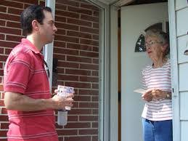

Some Changes for 2020
Respond Online
Respond via phone
Fewer canvassers
Citizenship question may be added

Slide 4
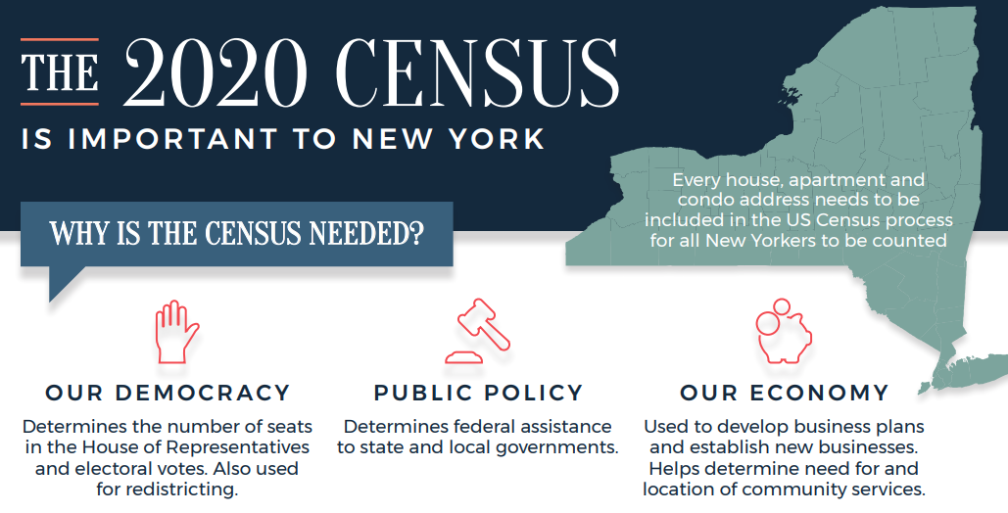
Need Complete, Accurate Census – What’s at Stake
and…

Slide 5
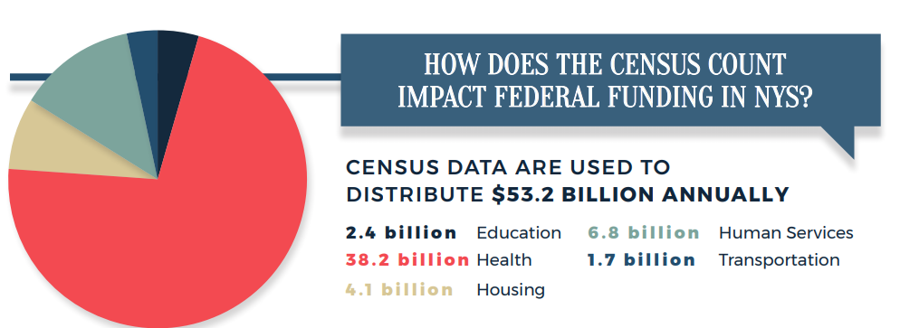
What’s at Stake: NY’s Federal Funding based on Census Numbers
For example: Title 1 Grants to school districts, National school lunch program, Special education grants (IDEA), Head Start, Early Head Start, Child care and development fund

Slide 6

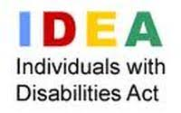




What does it means for our children?
Improving Academic Achievement of the Disadvantages Title 1 ESEA | IDEA | Early Head Start
National School Lunch Program (NSLP) | Child Care and Development Fund CCDF | Head Start

Slide 7
Undercount: Something New?
    Undercount – lower count of children than observed in other data sources
    Long-standing undercount in decennial censuses
    Demographers documented undercount of children (birth to 5)
    Net undercount of 2010 Census estimated at:
              4.6 percent for young children
              1 million young children*
              * Based on comparison of vital statistics & census numbers

Slide 8
Challenges to Accurate Counts of Children
Families frequently move English not first language Live with grandparents Live with non-family (in foster care) In multigenerational family Large households | Newborns Low income families Immigrant parents Have immigrants in household Younger parents Split between two homes Form completed for some, not all***
***Some parents noted they intentionally don’t report youngest

Slide 9

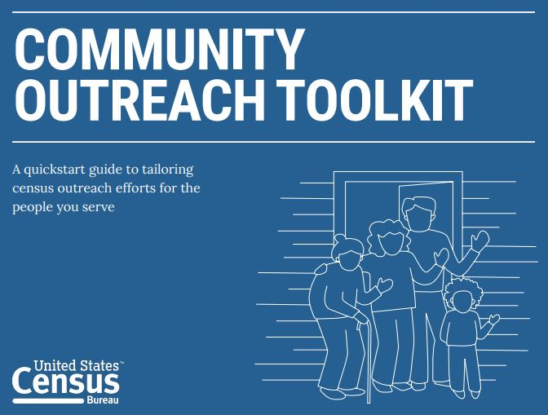
What does it means for our children?
Your
Informed parents
  Help parent become more informed about census benefits
  Messages that resonate: children & community
Coordinated Outreach (Get Out the Count - GOTC)
Citizenship question still in play
  Unreliable response on any survey
Trusted messengers promoting local benefits
  Community at-large
  Segments of community less likely to be counted

Slide 10
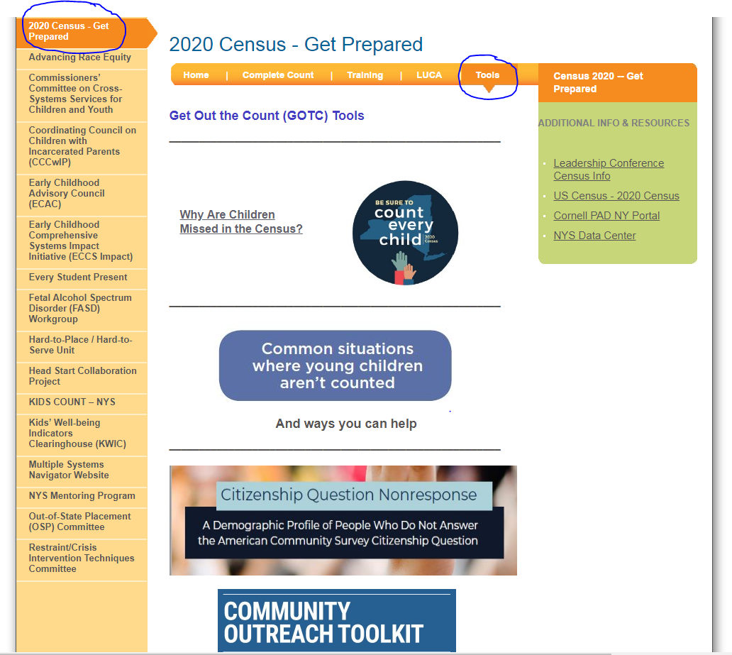
For more information
Go to:
  ccf.ny.gov
    Advancing Race Equity
      Tools
      Contact:
      cate.bohn@ccf.ny.gov
      mary.demasi@ccf.ny.gov

