Slide 1

Early Learning Video Project 2018
Goal: Provide New York State early childhood educators with video examples of purposefully planned high-quality environments that support developmentally appropriate practice for young children in grades P-3.

Slide 2
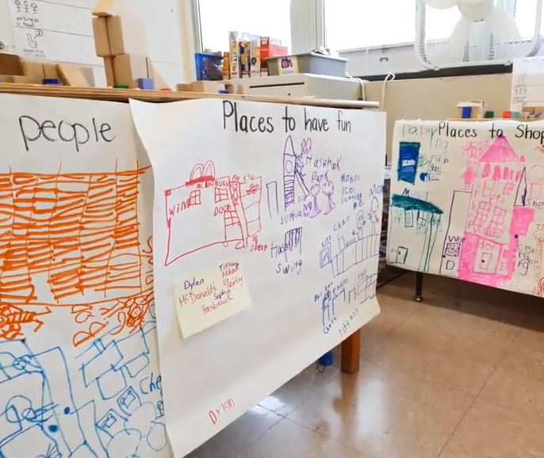
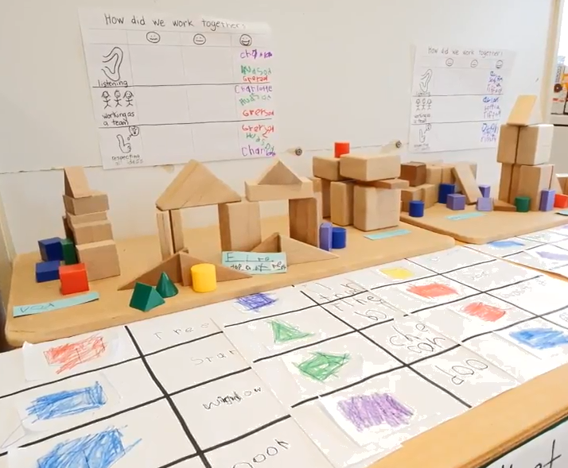
Purpose:
To provide a series of video resources to support educators with creating quality programs for children in Prekindergarten through 2nd grade
The series will include the following video resources:
  Prekindergarten
  1.Quality Environments
  2.Standards, Instruction, Curriculum, and Assessment
  Kindergarten
  1.Quality Environments
  2.Standards, Instruction, Curriculum, and Assessment
  1st and 2nd grade
  1.Quality Environments
  2.Standards, Instruction, Curriculum, and Assessment

Slide 3
Timeline of Project
January 2018: District approval, selection of classrooms and teachers to participate
February 2018: Meet with district administrators to discuss dates for video recording
Collection of student and teacher release forms
Discussions of content with district administrator and teachers
April-June 2018: Recording at districts
Summer 2018: create and edit videos
Fall 2018: Release of videos

Slide 4
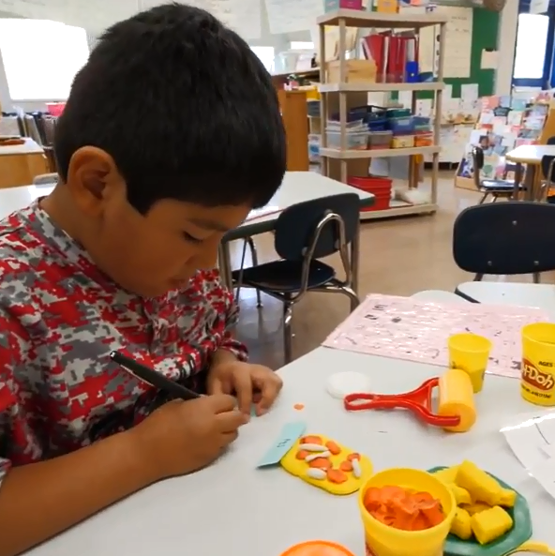
Participating Districts and Community Partners
Albany City School District
Achievements Kids Express Community Partner
Cohoes Central School District
Lansingburgh Central Schools
New Paltz Central School District
Niskayuna Central School District
Troy City School District

Slide 5
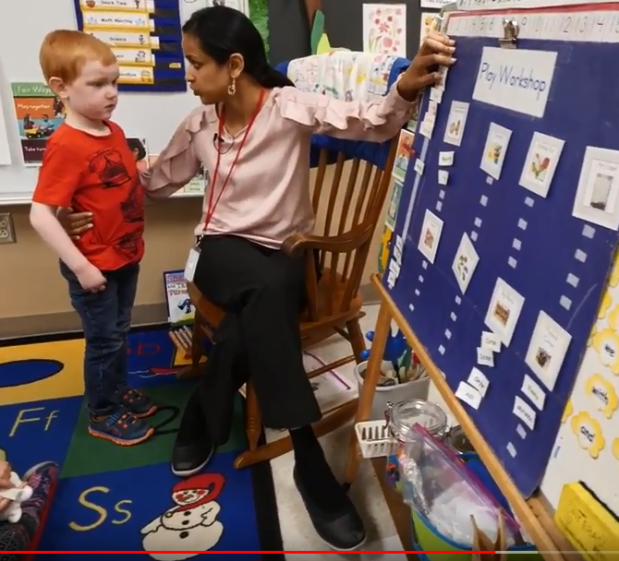
Creating Quality Kindergarten Instruction
video

Slide 6
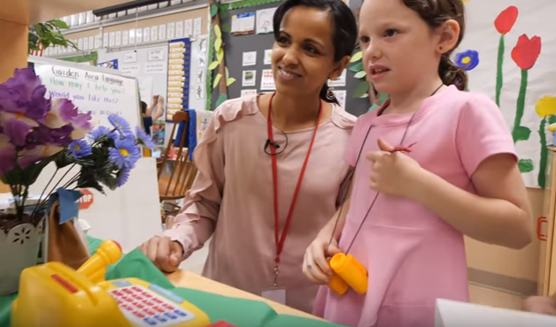
Project Status
Kindergarten videos are complete
  Environment
  Standards, Curriculum, Instruction, Assessment
Commissioner Elia completed an introduction video for the series
Prekindergarten videos are in process
Additional 1st and 2nd grade classrooms have been recorded
Next steps:
Finalize prekindergarten videos, begin 1st and 2nd grade

