Slide 1


Power to the Profession
Notes:
Thank you for the opportunity to be here today to share a little bit about the power to the profession.
How many have heard of this initiative?
How many have responded to the requests for feedback? Has CCAA sent out surveys?

Slide 2
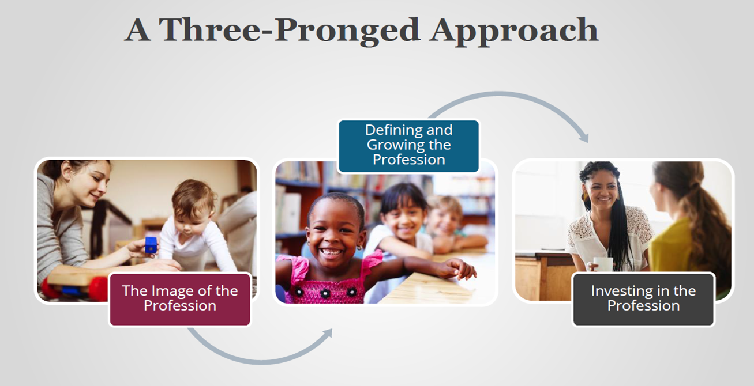
Power to the Profession
Notes:
Two year collaborative initiative; a national conversation designed to put the early childhood field itself front and center with many opportunities for engagement and input throughout the two years.

Slide 3
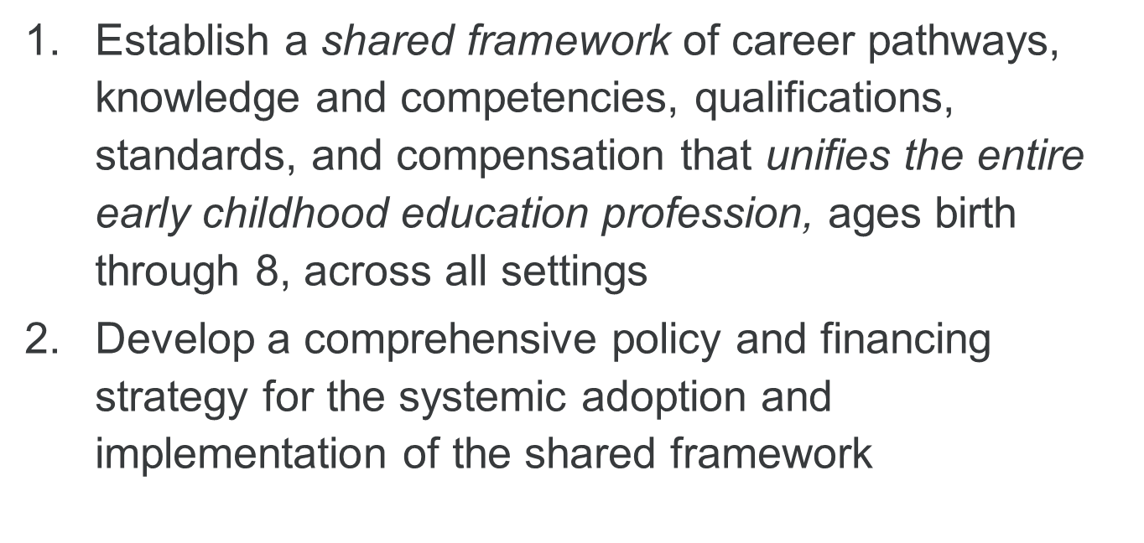
The Goals…

Slide 4
The What…8 Decision Cycles
Professional Identity and Boundary
  Advancing, Influencing & Governing vs. Influencing & Partnering
2. Competencies (General)
  Know, Understand, Demonstrate
3. Competencies (Specialized)
  Know, Understand, Demonstrate
4. Competency Attainment Source
  IHEs and non-IHEs where competencies can be earned
5. Qualifications and Pathways
  3-4 Levels of Mastery
6. Compensation Recommendation
  Recommendation Per Level of Mastery
7. Required Accountability and Quality
Assurance
Certification (Eligibility and Exam)
  Approved Competency Attainment Source (IHEs and non-IHEs)
8. Required Support and Infrastructure
  Educator, Higher Education, Program, State, Association
Transition to Finalizing and Implementing
Policy and Financing Agenda

Slide 5
Our Role…Give voice to defining our profession.
Surveys
Focus Groups
Virtual Town Halls
Sign up for mailing list (p2p@naeyc.org)
Connect with local affiliates

Slide 6

Questions & Discussions
Thank you!!!
http://www.naeyc.org/profession/

