Slide 1
NYSED Updates
Office of Early Learning
ECAC Membership Meeting – September 24, 2020

Slide 2
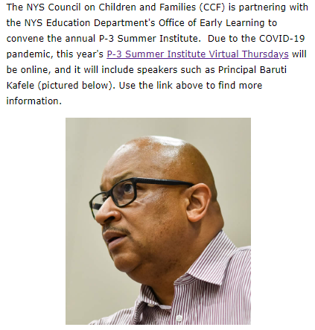
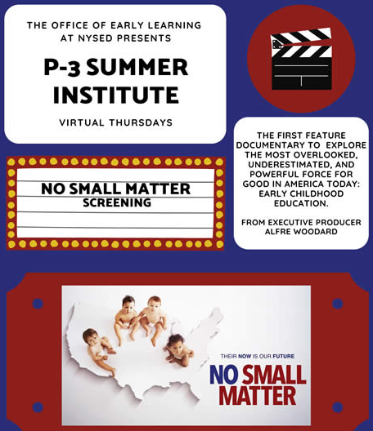
P-3 Virtual Summer Institute

Slide 3
NYS Prekindergarten Final Program Reports – 2019-2020
Review of NYS Prekindergarten Program Final Reports for 480 school districts, 3 BOCES, and 12 community-based agencies
Final Reports include information on number of students served, program location, data on students with disabilities, supports for emergent multi-lingual learners and their families, as well as health & safety protocols
Overview of budgets provided and final budget review with Grants-Finance Office

Slide 4
Universal Prekindergarten (UPK) Applications
Review of 426 districts who have the UPK grant only
Review includes: application, FS-10, Variance requests
75% of applications are returned to the district for various corrections
All budgets and Variance requests are signed, uploaded and approved to be sent to Grants Finance.
Technical Assistance provided to districts on allowable costs, coding, and variance requests.

Slide 5
Statewide Universal Full-Day Prekindergarten (SUFDPK) Applications
Review of 44 districts who have the UPK and State-Wide Full Day(SUFDPK) grants
Review of 12 direct contract CBO's (Agencies)
Review of 9 districts with the SUFDPK grant only
Review includes: application, FS-10, Variance requests, MWBE package
75% of applications are returned to the district for various corrections
All budgets and Variance requests are signed, uploaded and approved to be sent to MWBE and then Grants Finance.
Technical Assistance provided to districts on allowable costs, coding, and variance requests.

Slide 6
Voluntarily Registered Nursery Schools/Kindergartens
Process, review and approve applications from Voluntarily Registered Nursery Schools and Kindergartens; both new and those up for renewal.
Process, review and approve Annual Reports and Annual Fire Reports for all registered Nursery Schools and Kindergartens.
Provide Ongoing Technical Assistance to all registered Nursery Schools and Kindergartens.
Respond to telephone, email and mail inquiries and requests regarding the registered nursery school and kindergarten program.
Process, review and approve all Staff Background Forms for all new hires across the state.
Process, review and approve all Staff Study Plans when applicable.
Provide general assistance to applicants and potential applicants regarding their application to OEL.
Review corrective action plans and prepare correspondence to resolve areas of non-compliance for schools that have had a monitoring visit. Monitoring for 2020-2021 is TBD.

Slide 7
QUALITYstarsNY
Designed to help parents select the best possible care and education for their youngest children;
Sets universal program standards linked to star ratings;
Helps to improve the quality of early care and education programs;
Uses proven methods to assess, improve, and communicate the quality of early childhood education;
Meets the federal requirement for implementing a Quality Rating and Improvement System to receive federal funds
NYSED continues to target QUALITYstarsNY funding and support toward high need districts
Notes:
Quality Stars is NY's common, statewide, tiered quality rating and improvement system for early childhood programming
It is overseen by the Early Childhood Advisory Council (ECAC) and is part of larger effort to improve the quality of New York’s early learning and development system.
Important features of QUALITYstarsNY include a common protocol for the assessment of program quality and fiscal oversight, professional development, and technical assistance resources for supporting program improvement and rewarding program success.
QUALITYstarsNY is part of larger effort to improve the quality of New York’s early learning and development system in the following four areas: Learning Environment, Family Engagement, Qualifications and Experience, and Leadership and Management
QUALITYstarsNY is designed to include all settings where children receive care and education, including informal family child care and all programs and providers that are regulated by New York State agencies. (These include: center-based programs, family and group family child care, school-age care programs, Early Head Start and Head Start centers, Universal Prekindergarten (New York’s state funded prekindergarten program), Early Intervention center-based programs (Part C of IDEA), Preschool Special Education Programs (Part B of IDEA), and registered nonpublic nursery schools)

Slide 8
Building Supports for Emergent Multilingual Learners
The Emergent Multilingual Learner (EMLL) Profile is available in 24 languages
Strengthening guidance on how to identify and plan for linguistically and culturally responsive instruction and programming
Collaborating with OBEWL to build professional learning opportunities for educators on how to best support EMLLs and their families
Notes:
NYSED has developed resources and practices to help prepare all students for success, beginning in Prekindergarten.
The Emergent Multilingual Learner Profile for Prekindergarten students will assist educators in:
Gathering information about the existing home language(s) and linguistic experiences of all young learners
Planning for instruction and programming that is responsive to the needs of diverse learners and their families
Ensuring an effective and successful transition from prekindergarten to Kindergarten

Slide 9
Building Statewide Quality
Providing technical assistance and guidance to districts and agencies through remote contact (e.g., phone, emails, video conferencing) as they reopen schools/programs and throughout the year as they prepare for educating early learners
Strengthening OEL's monitoring protocols which to ensure comprehensive and consistent monitoring of program quality in providers of prekindergarten programs throughout New York State
Ensuring districts Prekindergarten Self- Assessment and Action Plans meet program quality standards for prekindergarten programs

