Slide 1

Workforce Technical
Assistance Projects
Kristen Kerr
Betsey Kenney
Karen Kissinger

Slide 2
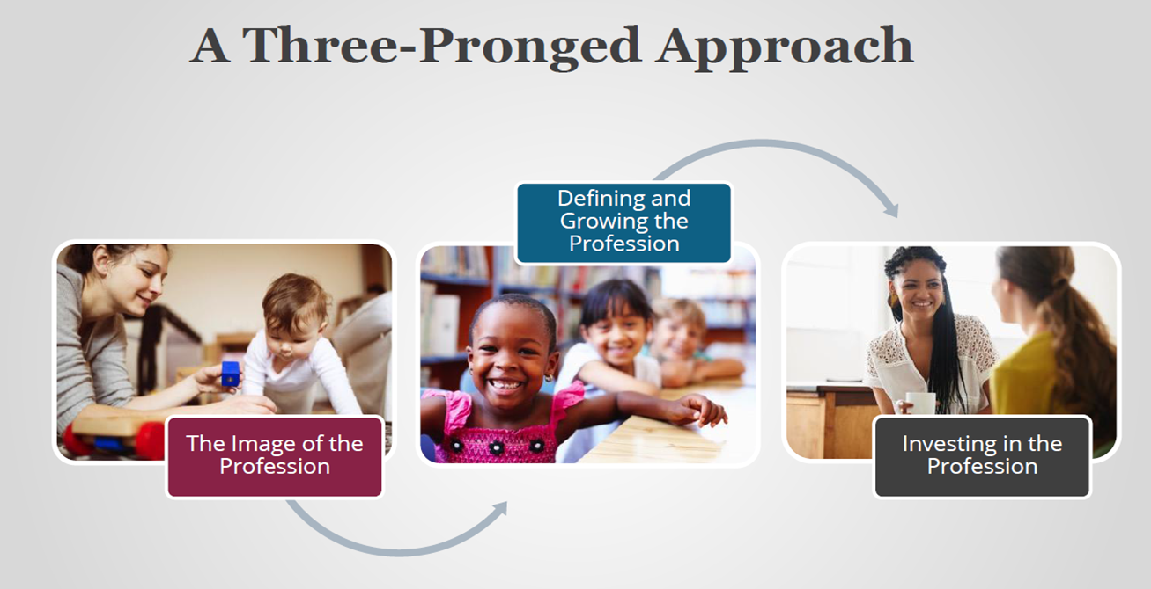
NYSAEYC Power to the Profession

Slide 3
NYSAEYC Power to the Profession
The Goals…
Establish a shared framework of career pathways, knowledge and competencies, qualifications, standards, and compensation that unifies the entire early childhood education profession, ages birth through 8, across all settings
Develop a comprehensive policy and financing strategy for the systematic adoption and implementation of the shared framework

Slide 4
NYSAEYC Power to the Profession
The What…8 Decision Cycles
Professional Identity and Boundary
  Advancing, Influencing & Governing vs. Influencing & Partnering
2. Competencies (General)
  Know, Understand, Demonstrate
3. Competencies (Specialized)
  Know, Understand, Demonstrate
4. Competency Attainment Source
  IHEs and non-IHEs where competencies can be earned
5. Qualifications and Pathways
  3-4 Levels of Mastery
6. Compensation Recommendation
  Recommendation Per Level of Mastery
7. Required Accountability and Quality
Assurance
Certification (Eligibility and Exam)
  Approved Competency Attainment Source (IHEs and non-IHEs)
8. Required Support and Infrastructure
  Educator, Higher Education, Program, State, Association
Transition to Finalizing and Implementing
Policy and Financing Agenda

Slide 5
NYSAEYC Power to the Profession
Our Role…Give Voice to defining our profession
Surveys
Focus Groups
Virtual Town Halls
Sign up for mailing list (p2p@naeyc.org)
Connect with local affiliates

Slide 6
SED-National Association of School Boards of Education (NASBE)
New York’s NASBE Stipend
Project Goals and Objectives
Overall Goal:
Increase the knowledge and competencies of early child and early education workforce
Objective 1:
Develop a unified competency-based early education preparation program that addresses the needs and diversity of children in early care and early education
Objective 2:
Build a professional development system for the early care and early education workforce

Slide 7
SED-National Association of School Boards of Education (NASBE)
Progress to Date
Regents Early Childhood Workgroup has committed to this work
  Next meeting: June 13th, at 8am - 9am at NYSED;
NYS Team attended March convening in D.C.;
Ongoing Discussions with SED’s Higher Education Office regarding pathways to certification, and strengthening the B-2 extension.

Slide 8
SED-National Association of School Boards of Education (NASBE)
Technical Assistance Needs
New York State hopes to benefit from the following support from NASBE:
Share opportunities to strengthen teacher preparation including coursework and field experience requirements;
Provide a better understanding of the national context of best practices for the early education workforce;
Disseminate effective strategies in cultural competency to support early educators so that every child will feel inspired to be a lifelong learner and succeed in life.

Slide 9
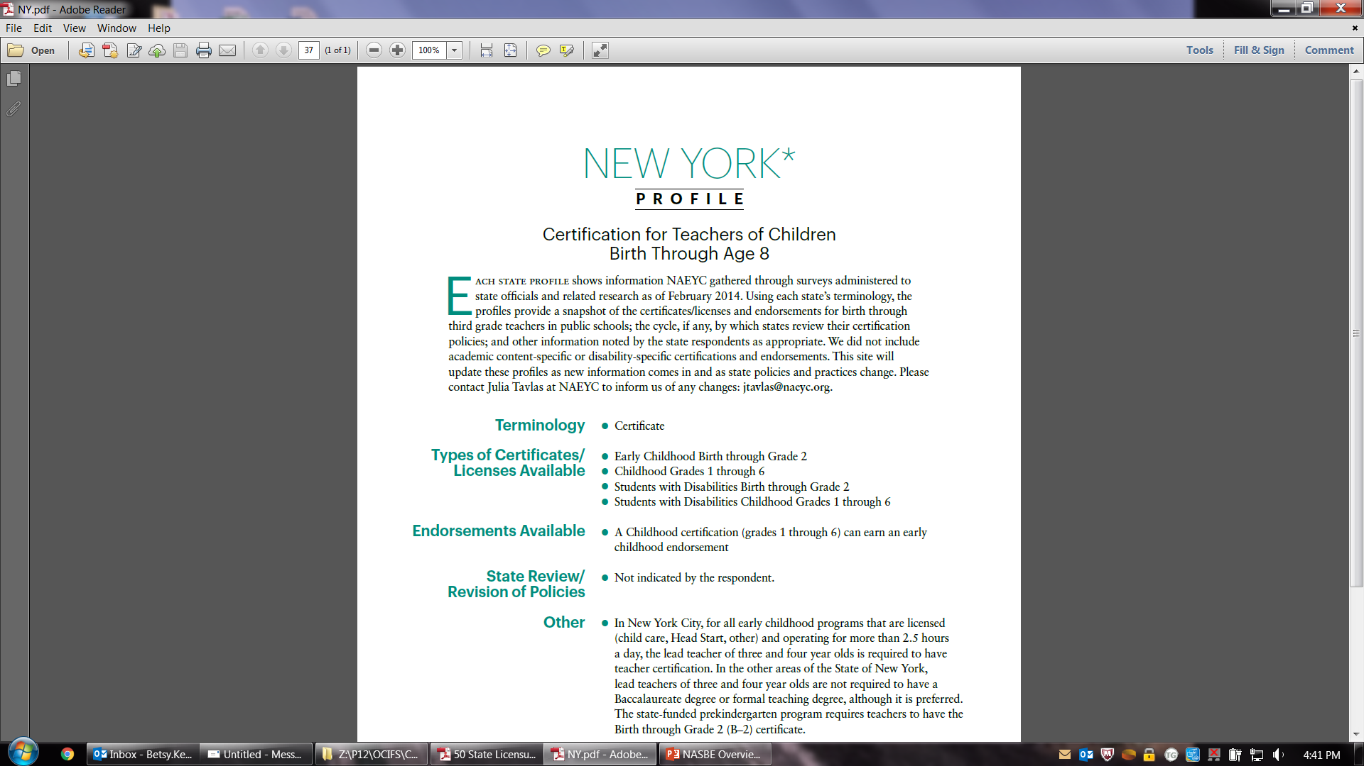
SED-National Association of School Boards of Education (NASBE)

Slide 10
ECAC-National Governors Association
National Governors Association Objectives
Conduct a scan to learn about other states’ early childhood workforce policies and practices
Learn how other state are using CCDBG funds to elevate the workforce
Consider legislative action opportunities for professional development
Develop an understanding of opportunities in WIOA and ESSA
Articulate the opportunity and challenge of early childhood programs implementing the new minimum wage law in NYS

Slide 11
ECAC-National Governors Association
Progress and Value of TA
Learned about apprenticeship design and leveraging other workforce investment board opportunity
Assessing the potential to incorporate background check clearances required by CCDBG in the statewide workforce registry
Governor’s office was an integral partner in the year of meetings and TA

Slide 12
ECAC-National Governors Association
Progress and Value of TA
Gained further knowledge about the IOM report, NAEYC’s Power to the Profession, and the Early Childhood Workforce Index
Connected with other states at face-to-face meeting in January and in multi-state TA call
Learned how another municipality managed to introduce and sustain an increased minimum wage for early childhood educators.

Slide 13
Questions
?

Slide 14
Insert Title

