Slide 1
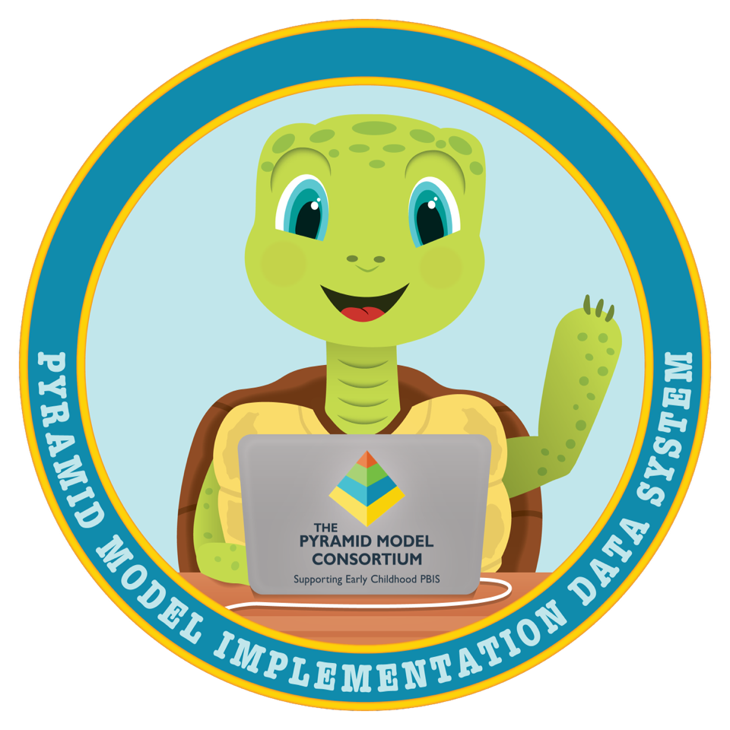
Requesting Your
PIDS Account

Slide 2
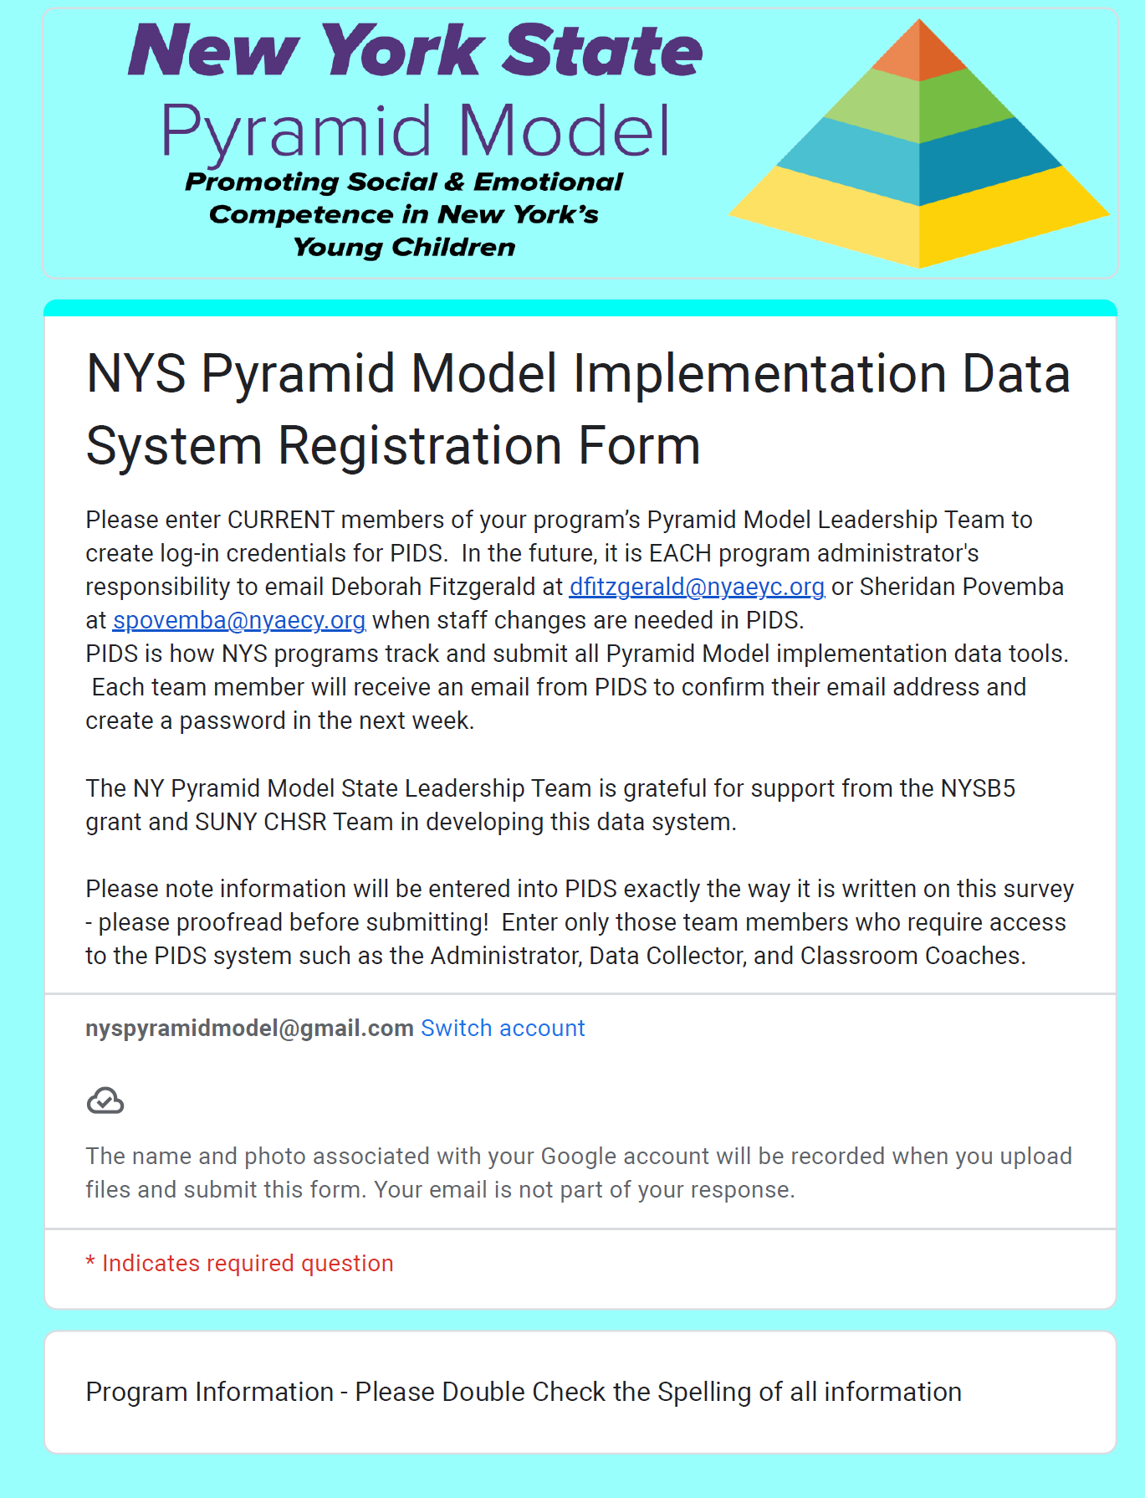
Requesting Your PIDS Account
After your application to become an Implementing program has been accepted you will receive a link to the PIDS Registration form.
This form should be submitted as soon as possible and include your Leadership Coach so they can help you to review your data in the system during Leadership Team Meetings.
Once the Registration form has been submitted you will receive a confirmation email with a link to start the process of setting up your account.
NOTE if you applied after July 1, 2024 you no longer need to submit a separate request.

Slide 3
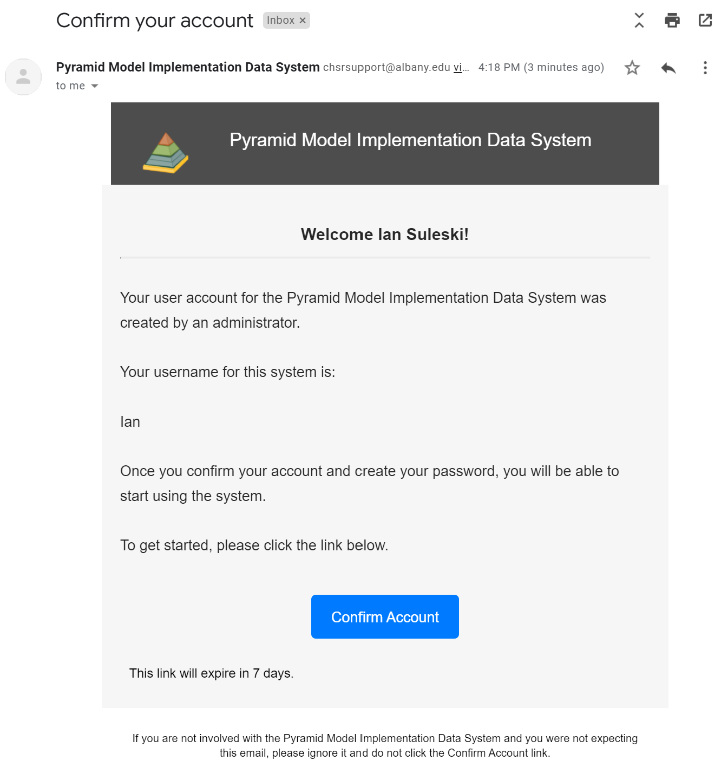
Getting Your PIDS Account Set Up
This is an example of the confirmation email PIDS will send when your account is created.
Open the email in your inbox and click “Confirm Account” to get started.
For detailed step by step instructions refer to the webinar link located here

Slide 4
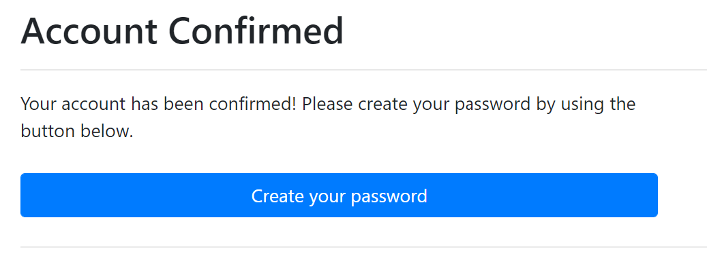
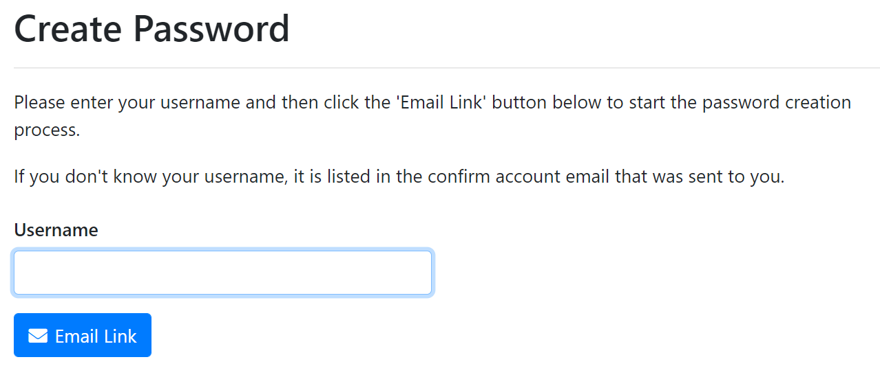
Have your username ready
After confirming your account, select “Create your Password”.
To create your password, you must first enter your username and select “Email Link”.

Slide 5
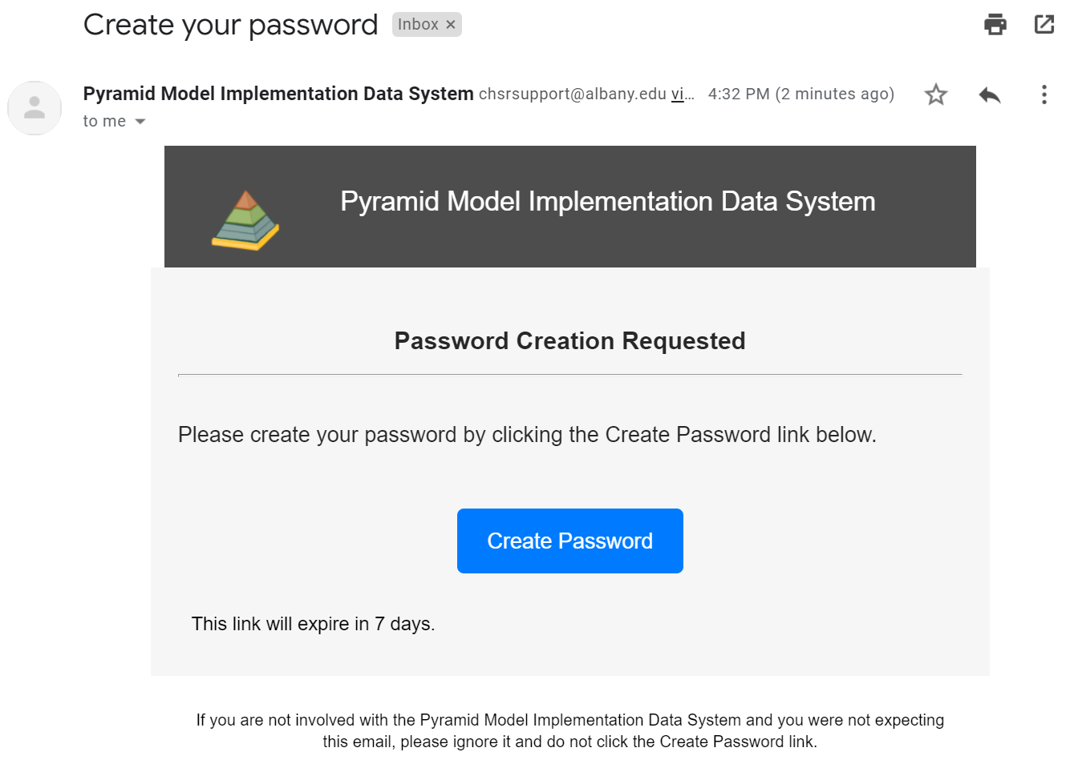
Creating your Password - Step 1
PIDS will then send you another email with a link to create your password.
Open the email in your inbox and select “Create Password”.

Slide 6
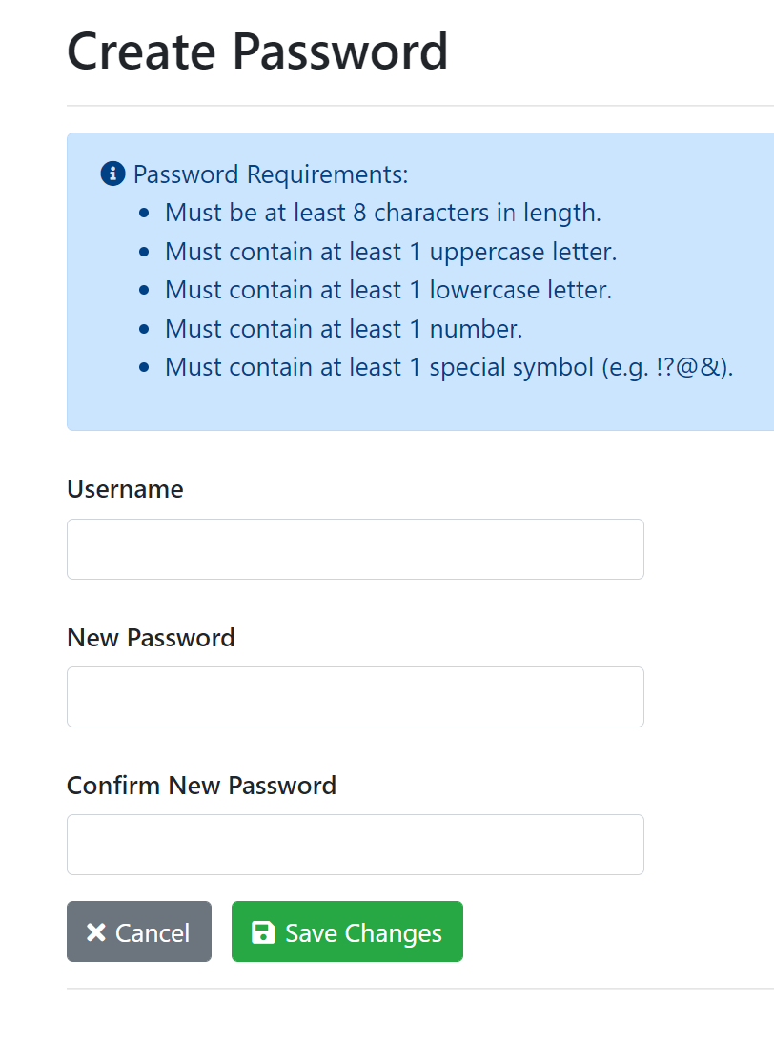
Creating your Password - Step 2
Enter your username and create your password in line with the password requirements.
Select “Save Changes” and you can now log into PIDS!

Slide 7
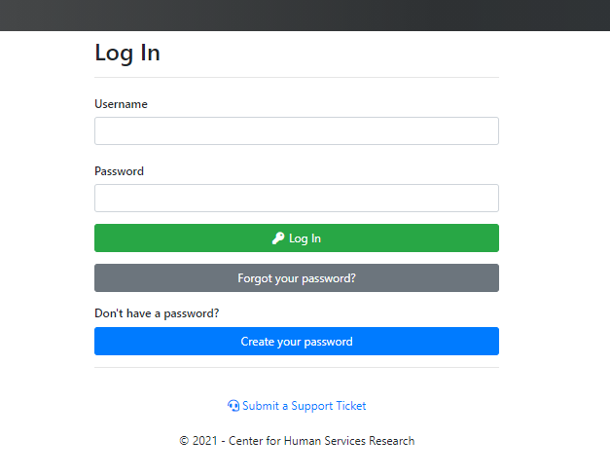
You are ready to Log In!
Log into PIDS with your Username and Password.
PIDS link: https://pids.azurewebsites.net/Account/Login

Slide 8
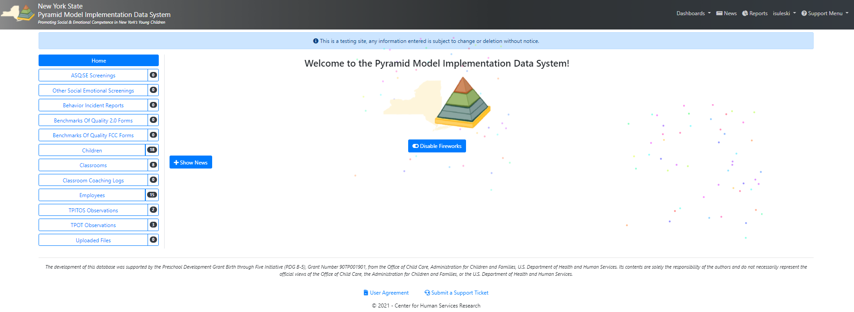
Your made it to the PIDS “Home Page”!
Check out our training videos under the support menu

