Slide 1
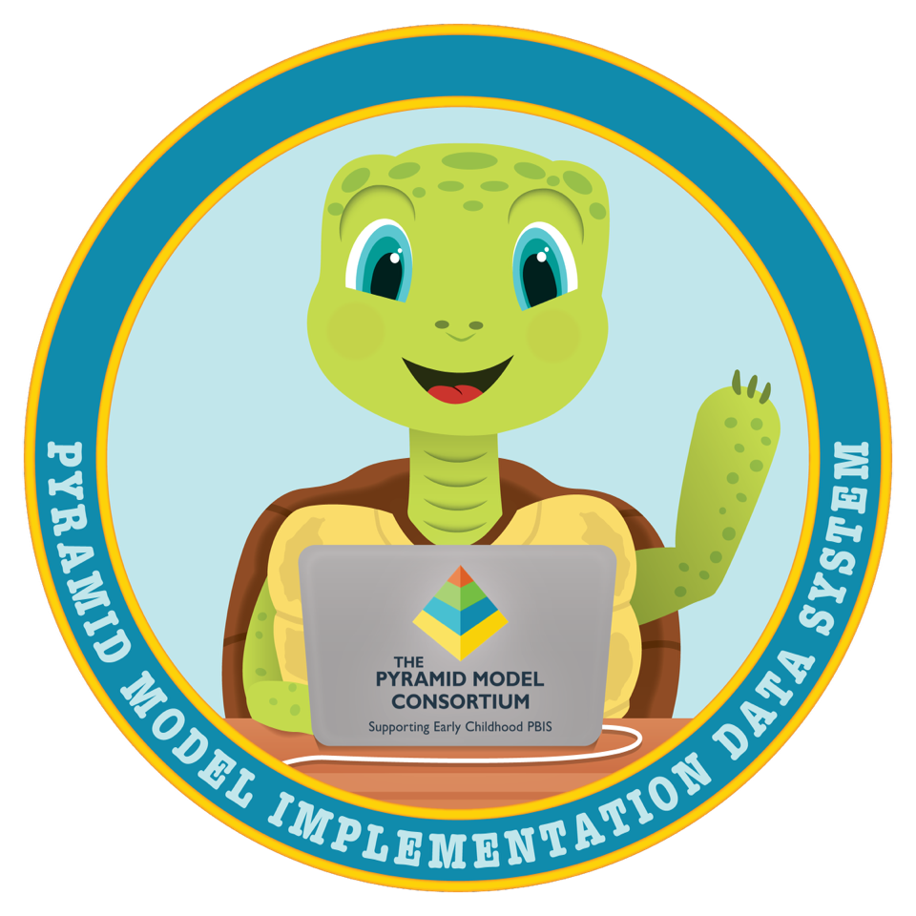
Entering Behavior Incident Reports

Slide 2
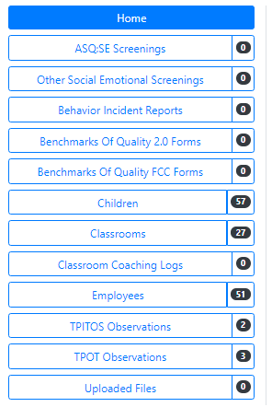
On the Home Page - Behavior Incident Reports
To enter a BIR for a child, begin by selecting the “Behavior Incident Reports” tab on the PIDS home page.

Slide 3
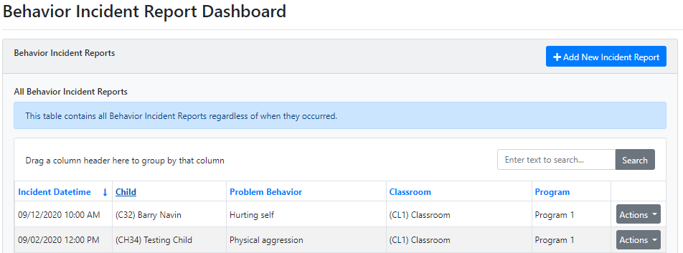
Behavior Incident Report Dashboard
You are now in your Behavior Incident Report (BIR) Dashboard where you will be able to see all the BIR screenings that you have added to your program.
Select “Add New Incident Report”

Slide 4
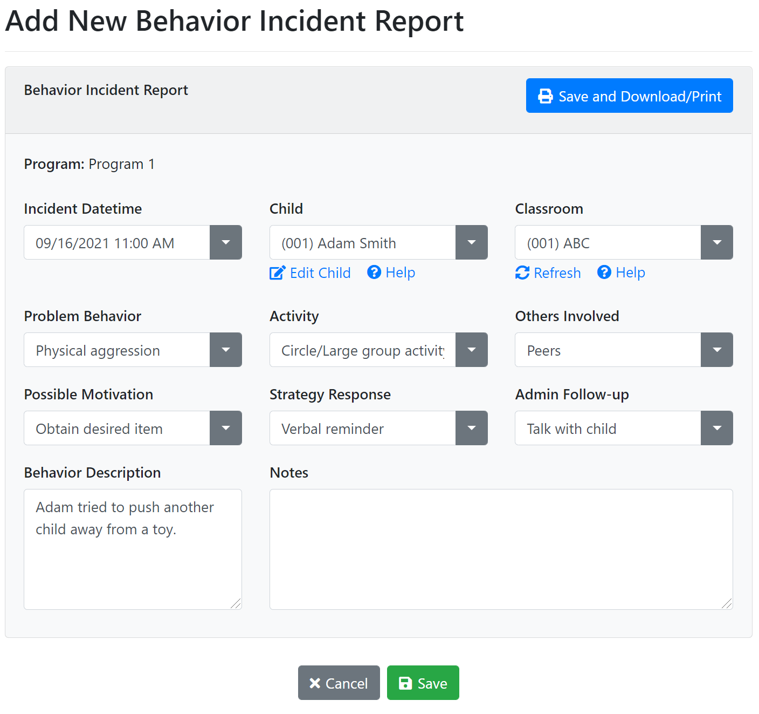
Linking BIR to Child & Entering the Details
Enter the Behavior Incident Report (BIR) information for your child.
Your child must be assigned to a classroom to make a BIR.
Select “Save” when complete.

Slide 5
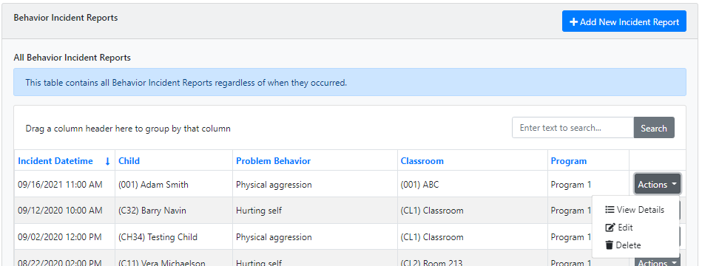
Accessing previous BIR’s
Once the BIR is created, you can go into the Behavior Incident Reports Dashboard at any time.
Select “Actions” in the same row to view, edit, or delete the BIRs.

