Slide 1
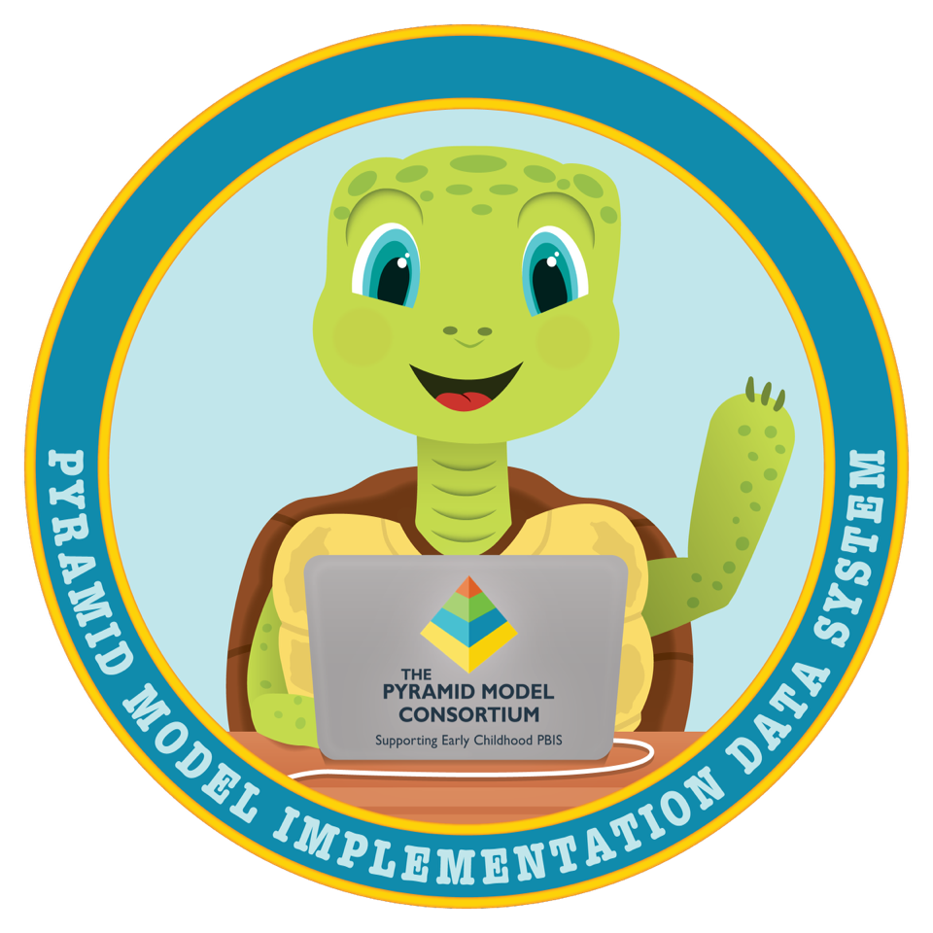
Entering Classroom Coaching Logs

Slide 2
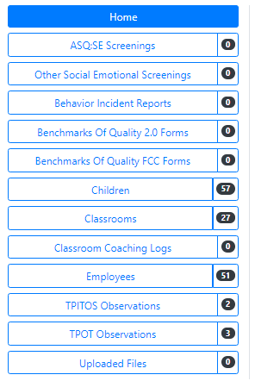
One the home page
Begin by selecting the
“Classroom Coaching Logs” tab on the PIDS home page.

Slide 3
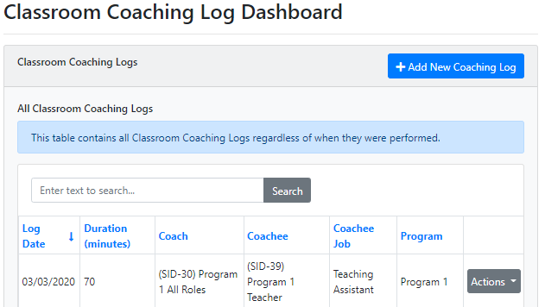
One the home page
You are now in your Classroom Coaching Log Dashboard where you will be able to see all the Coaching Logs that you have added to your program.
Select “Add New Coaching Log”

Slide 4
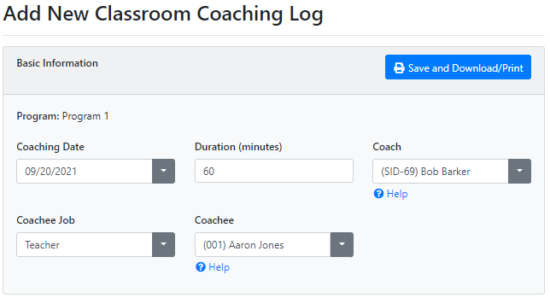
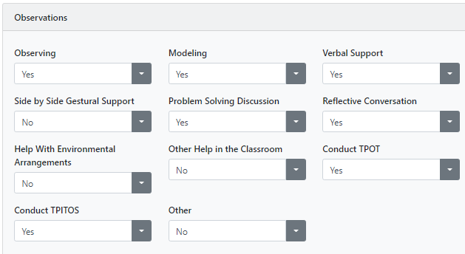
Creating a New Log and Enter data
Enter the Coaching Log information from your classroom coaching meeting.
Your Coach will not show up in the dropdown list unless they have their Practice Based Coaching (PBC) training in PIDS.
Beyond “Observations” there are additional sections for “Meetings” and “Follow-Up”.
Select “Save” when complete.

Slide 5
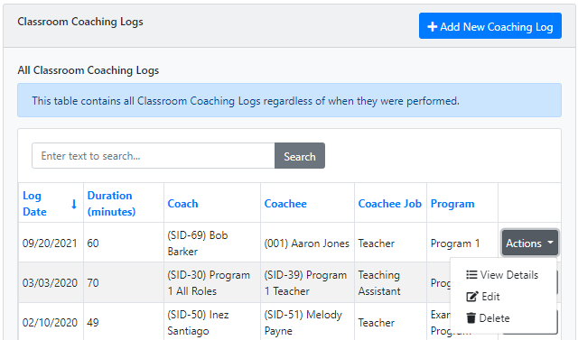
Accessing Previous Coaching Logs
Once the Coaching Log is created, you can go into the Classroom Coaching Log Dashboard at any time.
Select “Actions” in the same row to view, edit, or delete your Coaching Logs.

