Slide 1

Entering the Benchmarks
of Quality (BoQ’s)

Slide 2
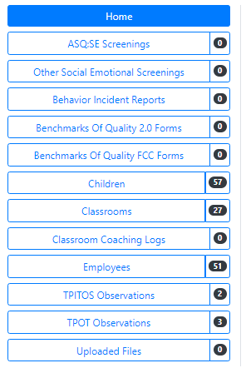
Entering BOQs into PIDS
To enter a BOQ for a program, begin by selecting the “Benchmarks of Quality Forms 2.0” tab on the PIDS home page.
Family Child Care (FCC) programs will select the “Benchmarks of Quality FCC Forms” tab.

Slide 3
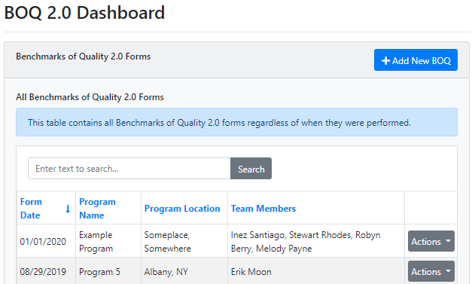
The Dashboard
You are now in your Benchmarks of Quality (BOQ) 2.0 Dashboard where you will be able to see all the BOQs that you have added to your program.
Select “Add New BOQ”

Slide 4
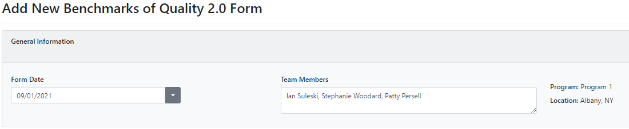
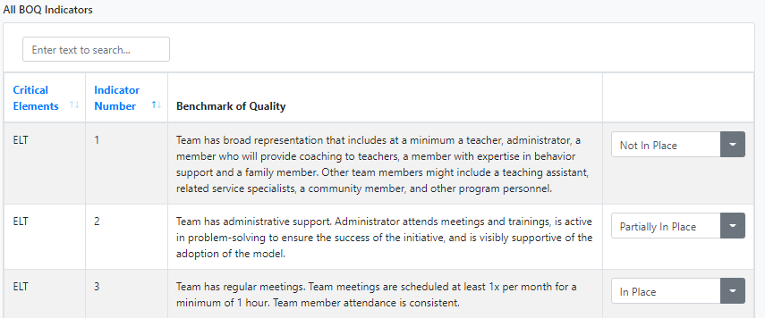
Updating your BOQs
Enter the date of the BOQ and then your team members present.
Below are BOQ Critical Elements and Indicators. You and your team will go through and answer each of the 41 indicators.
Select “Save” at the bottom when complete.

Slide 5
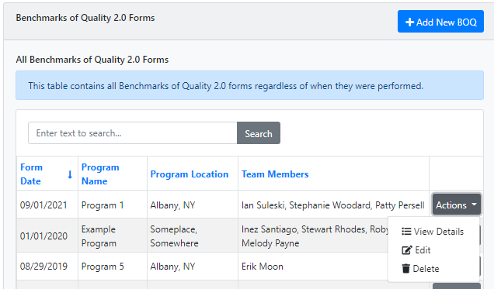
Accessing/Editing previous BOQs
Once the Benchmarks of Quality (BOQ) is created, you can go into the Benchmarks of Quality Dashboard at any time.
Select “Actions” in the same row to view, edit, or delete your BOQ.

