Slide 1
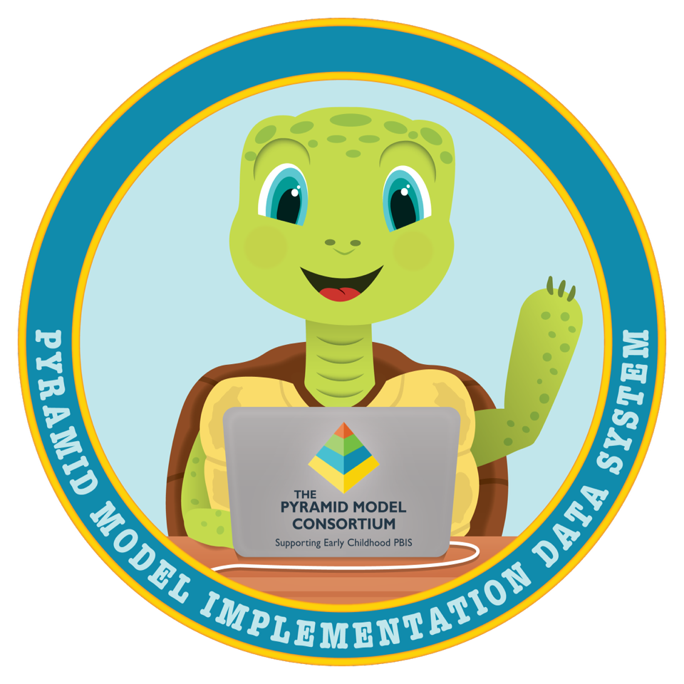
Accessing Data & Running Reports

Slide 2
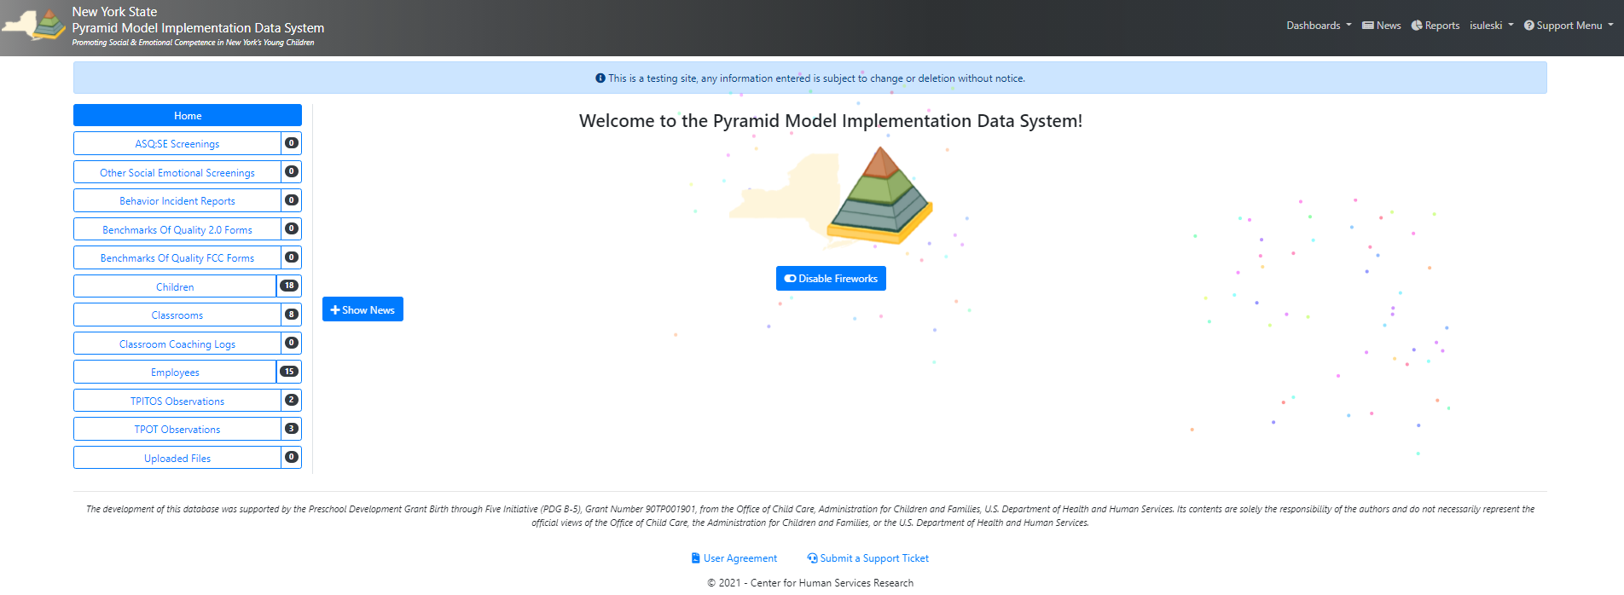

On the home page
To access all PIDS reports, select “Reports” in the navigation bar at the top right of the PIDS webpage.

Slide 3
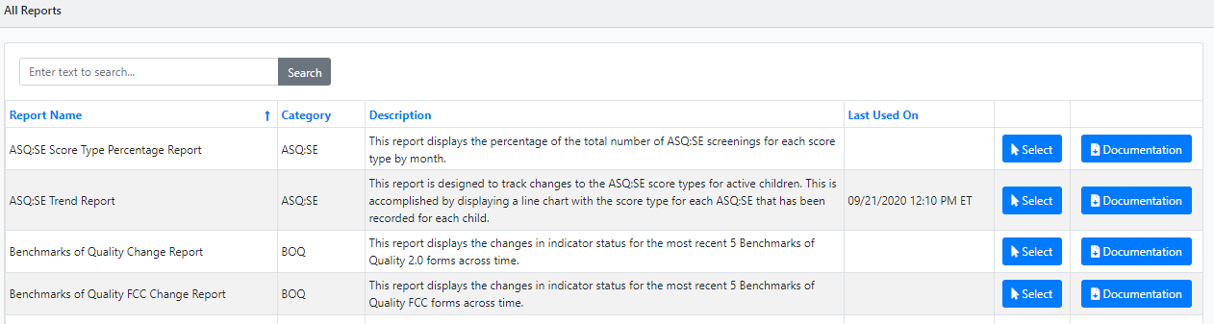
Report Selection Page
You can now “Select” and run any of the reports with your program’s data!
Scroll through the list or enter a keyword in the search bar to find a report.
Each report has a brief description of its contents. Select the “Documentation” to better understand what the report can show.
Notes:
Simply entering BOQ, TPOT, etc. into the search bar will filter the reports sufficiently.
- You can also select any of the columns to order the reports by that column.
Access to the reports and their contents will vary between user roles with Data Collectors having full access.

Slide 4
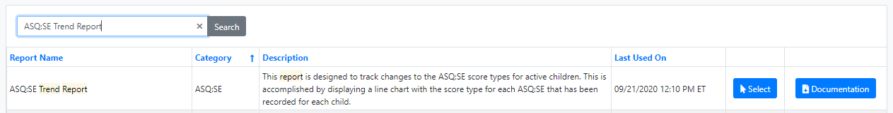
PIDS Reports – ASQ:SE
For this example, you are going to run an ASQ:SE Trend Report.
Locate the report in your report list or enter the name into the search bar.
“Select” the ASQ:SE Trend Report to proceed.
Notes:
Entering ASQ, ASQ:SE will also work. This works as a ctrl F function.

Slide 5
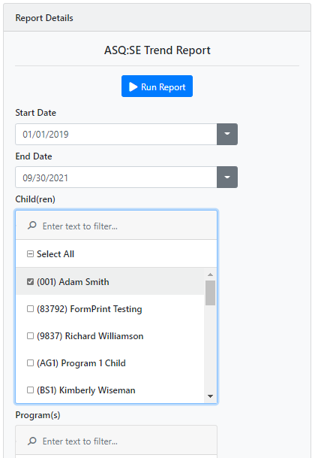
Creating the Report
After selecting your report, the Report Details will appear to the left.
Select your desired date range and filters.
  Each report has preset date ranges that you can adjust as needed.
  The filters will vary between reports.
Select “Run Report” when complete.
Notes:
The ASQ:SE Trend report is to the left as an example
Note: the report will use data from your whole program if you do not select any filters.

Slide 6
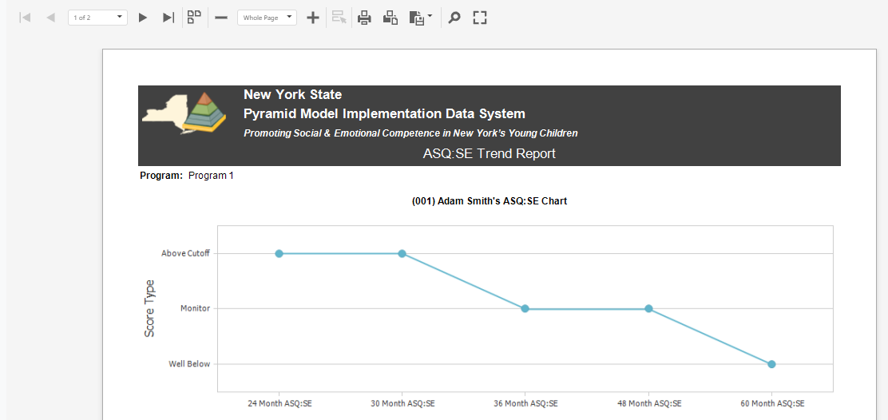
Printing your report
The ASQ:SE Trend Report above allows you to see and track the progress of social emotional screenings for your child.
Use the tool bar at the top to print or export any report.
Notes:
You can export to PDF, Excel, CSV, image, etc.

Slide 7
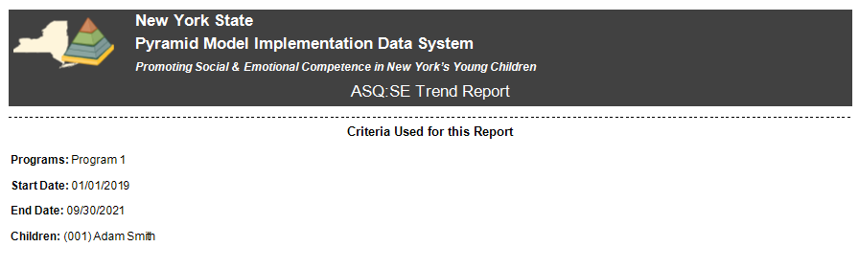
Reviewing the Report Criteria
Every report will have the Criteria used for the report at the end.
This will include all the filters and the date ranges you selected before running the report.
  In this example, the ASQ:SE Trend Report shows a child’s screenings from Program 1 between 2019-2021.

Slide 8
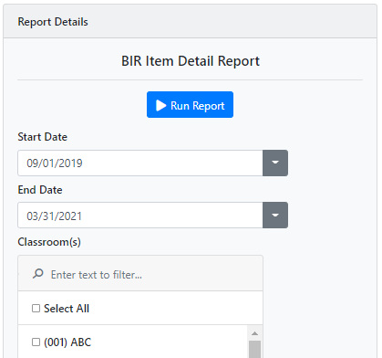
PIDS Reports – Behavior Incident Reports (BIR)
Locate and Select the “BIR Item Detail Report” in your report list.
Select the date range and choose the filters you want to apply below.
BIR reports also allow you to filter by all Problem Behaviors, Activities, Others Involved, etc. documented in the teacher’s BIR
Select “Run Report” when complete.

Slide 9
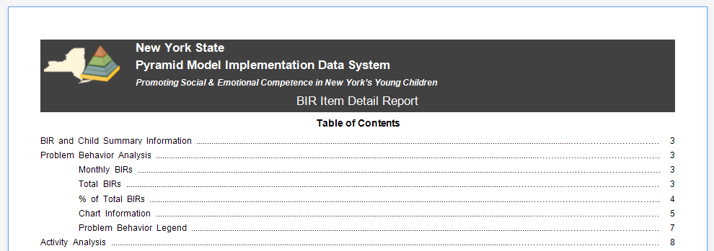
The Table of Contents
Longer PIDS reports like this one will have a Table of Contents at the beginning.
Move your cursor and click on a section of the Table of Contents to quickly navigate the report.
Notes:
Longer PIDS reports like this one can be upwards of 30 pages

Slide 10

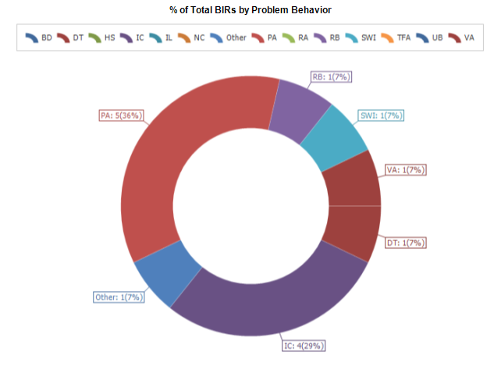
Report format options for the BIRs
The “% of Total BIRs by Problem Behavior” chart shows you which problem behaviors are most frequent.
In the chart, you can see Physical Aggression (PA) is the most frequent problem behavior with a total of 5 incidents accounting for 36% of all BIRs.
Notes:
The BIR Item Detail Report generates this chart for all items of the BIR:
Problem Behavior, Activity, Others Involved, Possible Motivation, Strategy Response, and Admin Follow-Up.

Slide 11
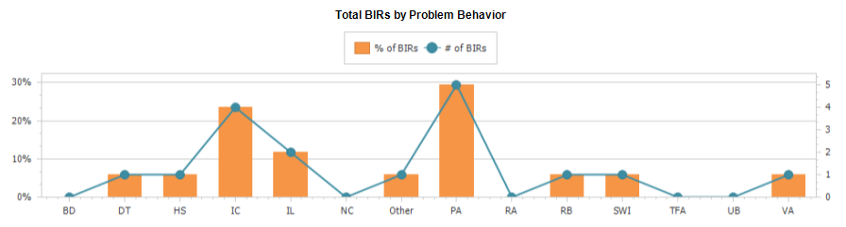
BIR’s Bar Graph
This bar graph in the “BIR Item Detail Report” also shows the number of BIRs by Problem Behavior and their percentage of all BIRs.
There are tables after every Problem Behavior, Activity, Other Involved, etc. section that have the totals by each BIR item.

Slide 12
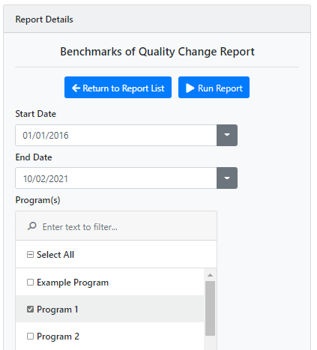
PIDS Reports – Benchmarks of quality (BOQ)
For this example, choose the Benchmarks of Quality Change Report from your report list.
This report will track the changes of your program’s BOQ’s and highlight when BOQ indicators change.
Select the date range or use the preset date and run the report.

Slide 13
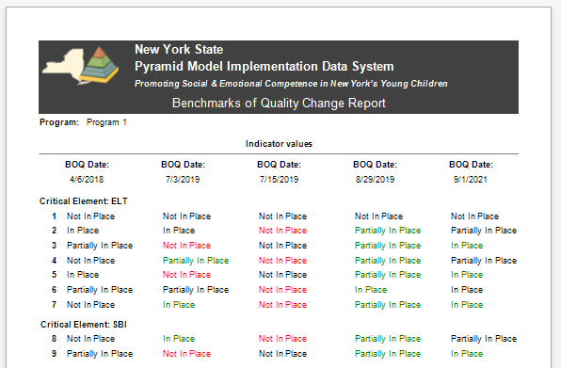
BOQ Progress Over Time
The example above is the BOQs from a program from 2018-2021 with each column representing a different BOQ.
All indicators in “Red” have went down from the last BOQ (Partially in Place to Not in Place).
Notes:
The Green indicators have gone up since the last BOQ (Not in Place to Partially in place)
A legend is included for the critical elements at the end of the BOQ Change Report.

Slide 14
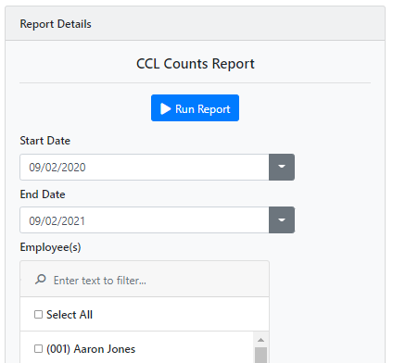
PIDS Reports – Classroom Coaching Logs
For this example, choose the Classroom Coaching Log (CCL) Counts Report.
The CCL counts report will show the total of each coaching log item observed during coaching sessions.
Select the date range and run the report.

Slide 15

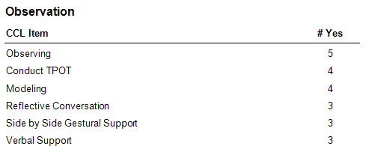
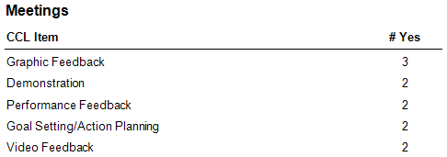
Classroom Coaching Log Report Details
The CCL Counts Report includes the total counts of every coaching log for the item in each section:
  Observation
  Meetings
  Follow-Up
This gives you the number of “Yes” counts for each item so you can know which are most frequent during coaching.

Slide 16
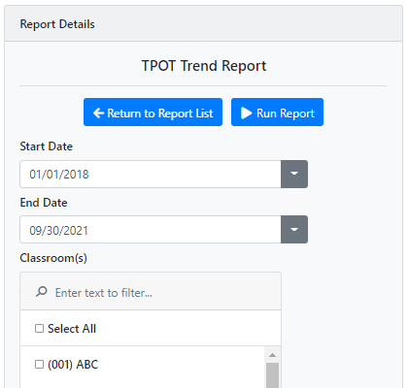
PIDS Reports – TPOT/TPITOS
For this example, choose the TPOT Trend Report.
The TPOT Trend report will show your TPOT scores for each indicator overtime.
Because the structure of the TPOT and TPITOS are very similar, they identical reports.
Select your date range and run the report.
Notes:
.

Slide 17

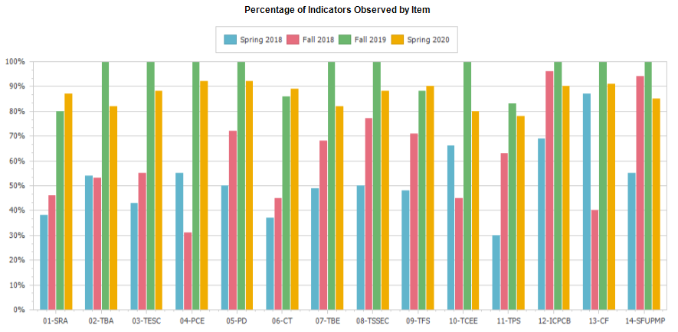
TPOT/TPITOS - shift in practices comparison
The results of the TPOT Trend Report above show the scores for each indicator (1-14) every Spring and Fall.
The indicators for this program generally go up from the first TPOT observation in Spring 2018 with a slight decline in the last one in Spring 2020.
Notes:
This information can help assess your classrooms and how they adhere to Pyramid Model Practices.

